Slide 1



Yaniv Valik, VP Products

Slide 2




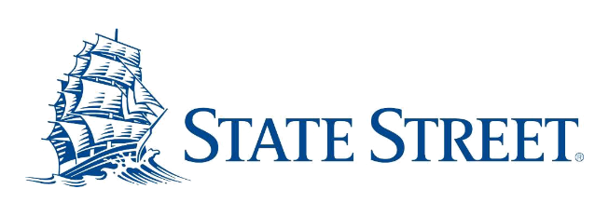




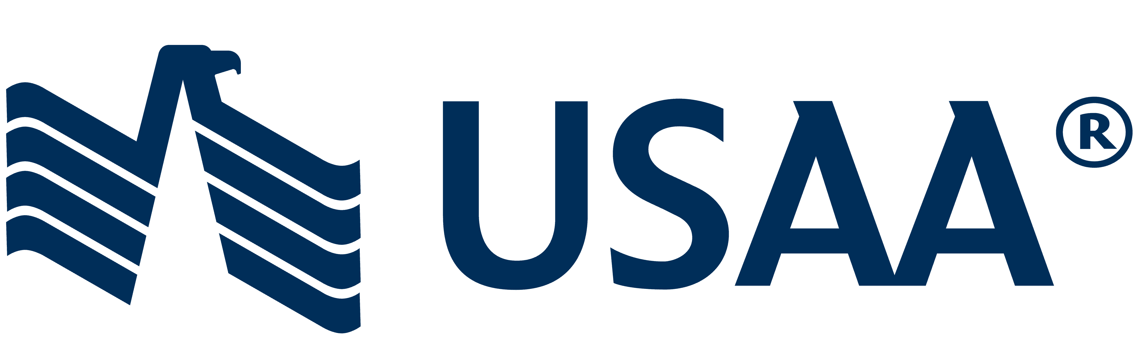
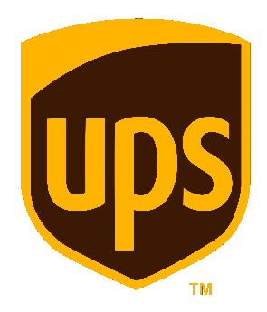



ABOUT US
Notes:
Continuity was founded back in 2005.
We have two product offerings:
Helping our customers to prevent outages on their critical infrastructure (AG); (recoverability)
…and helping them to secure their data storage environment (SG).
Today we’ll focus on the second part of our mission – securing the storage environment.

Slide 3





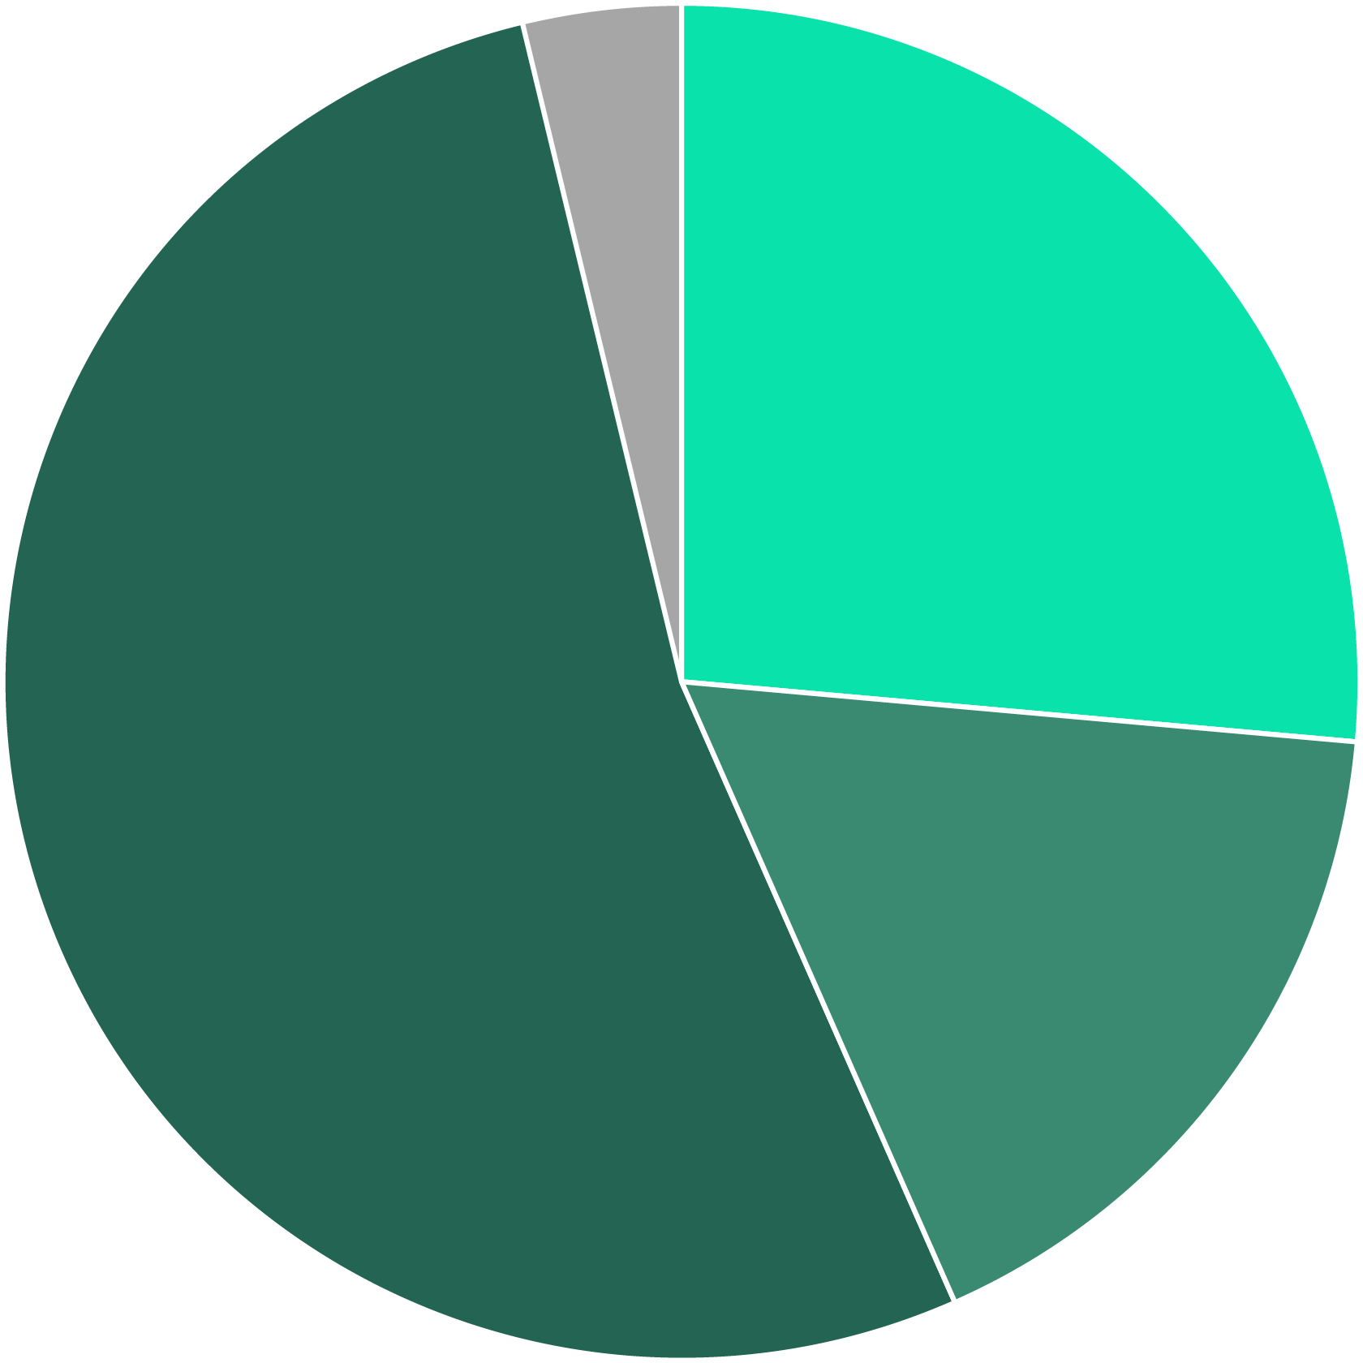


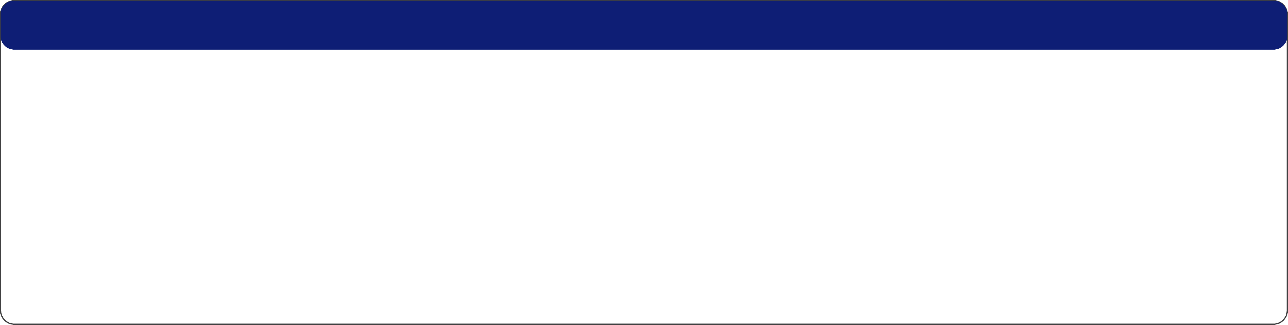


SUCCESS STORY - LEADING BANK
THE CUSTOMER
An American multinational bank and financial services company*
CHALLENGE (CONTINUED)
Manual analysis is not feasible
Failure to meet auditor deadlines for remediating the gap
CHALLENGE
No repeatable method to assess the security of business-critical enterprise storage and backup systems
SOLUTION BY CONTINUITY SOFTWARE
Continuous scanning and analysis of the bank IT systems worldwide
Low 2
Automatic detection of security risks
Ransomware concern
Overall health and compliance reports
Critical 14
Storage / Backup Vendor
Vulnerability score
Configuration Compliance score
Medium 28
Dell EMC
Cohesity
IBM
Pure Storage
Rubrik
Hitachi Vantara
NetApp
53
39
High 9
93
100
65
22
7
71
85
52
21
96
88
35

Slide 4





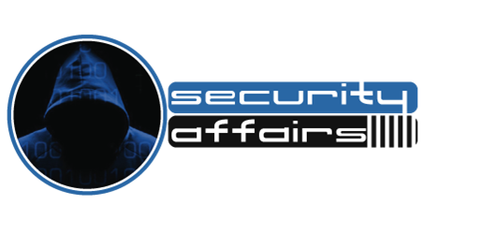
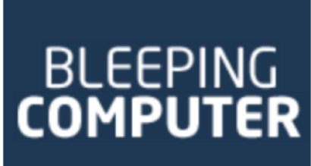
“The Conti ransomware gang has developed novel tactics to demolish backups…. According to Palo Alto Networks; “it’s one of the most ruthless of the dozens of ransomware gangs that we follow.”
“The ransomware was targeting poorly protected Network-Attached Storage (NAS) devices. The threat actors exploited known vulnerabilities.
“This new ransomware gang is known to seek out and delete any backups to prevent them from being used by the victim to recover their data.”

Slide 5








“
“
“
In my experience CISOs have not given the storage layer enough attention in the past in protecting their businesses… including myself.
I’ve been using Qualys for 2 years, but that does not scan my backup or my storage.
This definitely addresses a gap in the market, which a lot us didn’t even think about!
We tried doing it ourself [manually, twice a year]… We have to keep up to date with all the latest storage configuration security guidance that’s out there – and that’s a big job!
Automating this process would be of significant value to us.
”
”
”
JOHN MEAKIN
Former CISO
JEFF FARINICH
CISO
Brad Schaufenbuel
CISO
Notes:
Today StorageGuard is available to deploy on-prem within any major organization
Using its built-in knowledgebase, StorageGuard runs thousands of storage security checks…
…to meet both your own security baselines and regulatory standards.
All major storage platforms are supported,
and you can even add your own custom checks.
Here are examples of some of the Recommendations / Key Takeaways from a recent Risk Assessment with a client
Enable 2-factor authentication for sensitive systems such file storage and backup systems
Enable ransomware prevention features on file and object storage systems such as ransomware file filtration policies and on-box anti-ransomware
As guided by CISA, disable unsecure file SMB protocol versions that have been exploited to launch ransomware and other attacks
Consider increasing cyber-recoverability assurance by setting up retention-locked non-erasable snapshots and backup copies (on systems where currently such copies are unavailable or when alternate methods such as air gaps are not in place for recovery/backup copies)
Restrict access to file shares to designated IP ranges and avoid granting access to all IP addresses
To protect against eavesdropping and data leakage, consider encrypting data in transit through various connections and protocols (CIFS, NFS, replication, remote support, etc.)
Consider enabling storage area network authentication features for improved storage security.

Slide 6
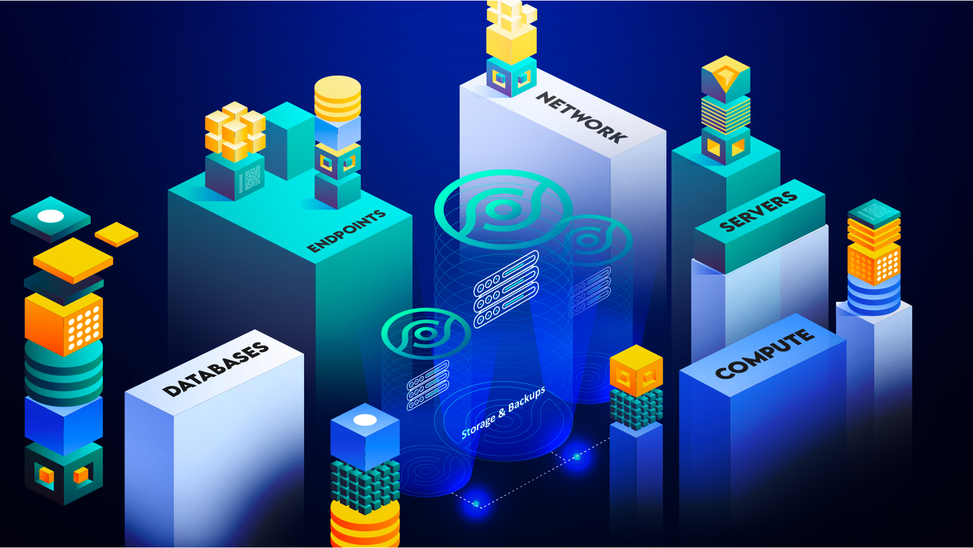


Why StorageGuard
How do you automate, validate, and enforce the secure configuration of your storage and backups?
“Perimeter defenses can no longer protect organizations’ assets & data”
NIST & MITRE, 2021 Cyber Resiliency Guide
Notes:
There are a plethora of vulnerability management, EDR/XDR, and other security tools out there. Why StorageGuard?
Existing security tools focus on network, servers/OS, applications
Nessus, Qualys, Rapid7, etc.
What about enterprise storage and data protection systems?
Storage and data protection platforms hold your most valuable asset – your data
Storage-specific security baselines and policies are often poorly-defined or non-existent
A typical storage environment consists of multiple vendors / models (Dell, IBM, HP, Cisco, Brocade, NetApp, …)
Demonstrating audit compliance is typically a manual effort
StorageGuard closes the gap in security for storage and backup platforms

Slide 7
THE GAP
Storage Management
Storage FC Network
Storage
Software
Block Storage
Object Storage
SAN
NAS
Data Protection Systems
Backup
Systems
Storage Virtualization
Server-Based Storage
Notes:
OS and network configurations are secure
Nessus, Qualys, Symantec, …
What about enterprise storage systems?
Block, File & Object storage are vulnerable!
Are my storage systems violating security baselines?
did I find and fix all vulnerabilities? non-compliance issues?
Multiple vendors / models (EMC, IBM, HP, Cisco, Brocade, NetApp, …)
How do we validate the configuration of storage systems, SAN switches, cloud storage, storage management servers, Server-based SAN and data protection appliances?

Slide 8
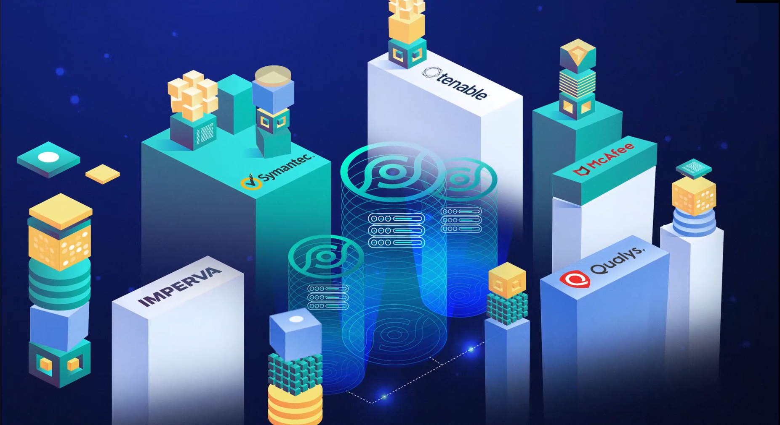

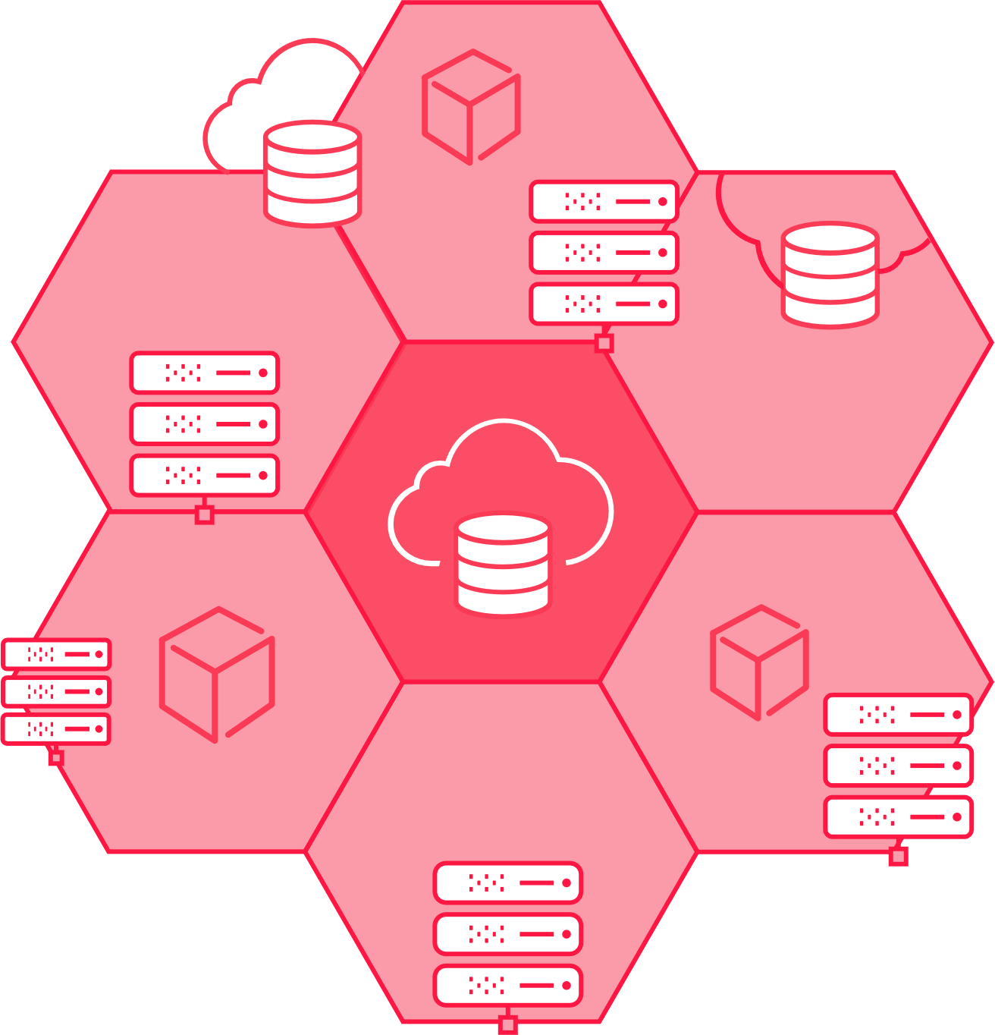
THE GAP
End-user devices
“Ransomware attacks are targeting organizations’ network-attached storage (NAS) and backup storage devices.”
Host OS
End-user devices
Mobile OS
Storage & Backup
The Ultimate Line of Defense Against Cyberattacks
Web Servers
Storage and Backup Systems
Host OS
Web Servers
End-user devices
DBMS
Notes:
OS and network configurations are secure
Nessus, Qualys, Symantec, …
What about enterprise storage systems?
Block, File & Object storage are vulnerable!
Are my storage systems violating security baselines?
did I find and fix all vulnerabilities? non-compliance issues?
Multiple vendors / models (EMC, IBM, HP, Cisco, Brocade, NetApp, …)
How do we validate the configuration of storage systems, SAN switches, cloud storage, storage management servers, Server-based SAN and data protection appliances?

Slide 9


THE GAP
Endpoints
“Ransomware attacks are targeting organizations’ network-attached storage (NAS) and backup storage devices.”
Servers
Storage and Backup Systems
DBMS
Compute
Web Applications
Notes:
OS and network configurations are secure
Nessus, Qualys, Symantec, …
What about enterprise storage systems?
Block, File & Object storage are vulnerable!
Are my storage systems violating security baselines?
did I find and fix all vulnerabilities? non-compliance issues?
Multiple vendors / models (EMC, IBM, HP, Cisco, Brocade, NetApp, …)
How do we validate the configuration of storage systems, SAN switches, cloud storage, storage management servers, Server-based SAN and data protection appliances?

Slide 10
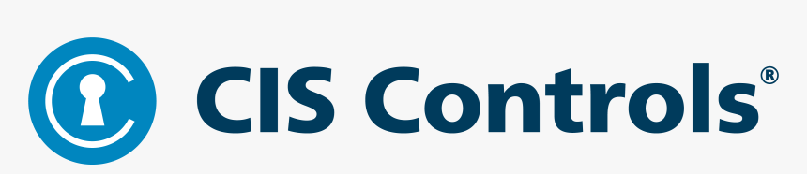
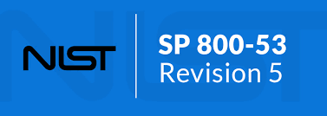
“
“
While storage infrastructure can be one of the most-impacted solutions attacked by ransomware, it initially receives limited attention by security and storage leaders.
Conduct both automated authenticated and unauthenticated scans
”
”
“
Develop and maintain a current baseline configuration…
Establish ... the most restrictive mode
Implement the configuration settings
Identify and approve deviations from established configuration setting
Monitor and control changes to the configuration settings
”

Slide 11
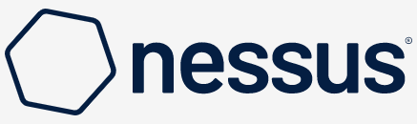
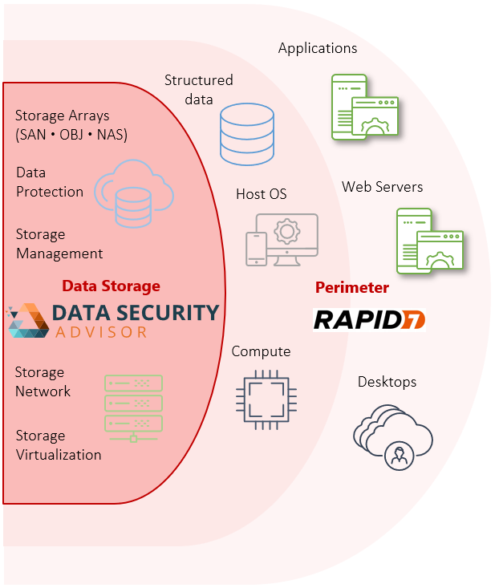
StorageGuard vs Nessus
Markets | Vulnerability Assessment Security Posture Management Data storage security | Vulnerability Assessment Security Posture Management Web Application security
Focus Area | Data Storage and Backup | Network, Host and Desktops
Main Scanned Platform Types | Storage OS Storage / Backup Software Network (Storage) | Host / Mobile OS, DBMS Host Software Network (Ethernet)
Coverage for Storage/Backup Systems | >88% | <5%
Storage/Backup VULN. Catalog | Up to date / Continuously updated | Poor / Outdated / Rarely updated
Storage/Backup CONFIGURATION Hardening/Compliance Checks | >1500 | Negligible
AUTHENTICATED SCAN for Storage/Backup Systems | Yes | Nearly none
Storage/Backup Configuration Change Tracking | Yes | No
Storage/Backup Analysis method | Storage/Backup-Aware scan Storage-savvy analysis Deep understanding of Storage/Backup models and configurations Authenticated scan running per-technology/model API/CLI Scanning through specific API/CLI of Dell PowerMax, Pure, Cohesity, Dell ECS, EMC Data Domain, Dell Unity and more. | Generic Web / Linux / Network Generic Web App / Linux Vulnerability detection Generic network/credential-less checks
API & Integration | Yes | Yes

Slide 12

StorageGuard vs Qualys
Markets | Vulnerability Assessment Security Posture Management Data storage security | Vulnerability Assessment Web Application security
Focus Area | Data Storage and Backup | Host and Desktops
Main Scanned Platform Types | Storage OS Storage / Backup Software Network (Storage) | Host / Mobile OS, DBMS Host Software Network (Ethernet)
Coverage for Enterprise Storage | >88% | <9%
Storage Vulnerability Knowledgebase | Up to date / Continuously updated | Poor / Outdated / Rarely updated
Storage Configuration Hardening Checks | >1000 | <100
Configuration Change Tracking | Yes | No
Scan Frequency for Enterprise Storage | User-defined Daily (default) / Every X hours / Weekly / Monthly / User-defined / Ad-hoc | User-defined Typically, infrequent (every X months)
Analysis method | Storage-Aware scan Storage-savvy analysis including review of LUNs, volumes zoning, masking, etc. Specialized Storage vulnerability and configuration hardening analysis Storage access control analysis Storage software analysis Storage CLI / API / Config files | Generic Web / Linux / Network Generic Web App / Linux Vulnerability detection Generic network checks
API | REST, SQL | REST
Policy & Compliance | Yes | Yes
Integration | Yes | Yes

Slide 13

“
“
While storage infrastructure can be one of the most-impacted solutions attacked by ransomware, it initially receives limited attention by security and storage leaders.
While storage infrastructure can be one of the most-impacted solutions attacked by ransomware, it initially receives limited attention by security and storage leaders.
”
”
Innovation Insight for Cyberstorage Solutions to Protect Unstructured Data Against Ransomware,
October 2021

Slide 14

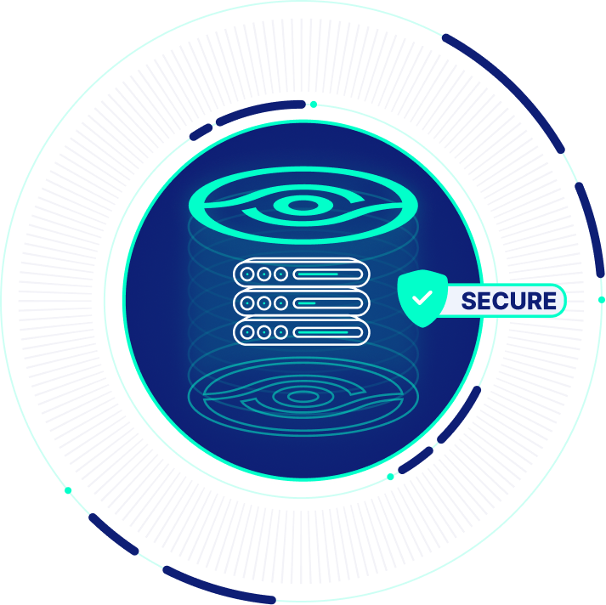
Vulnerability Management and Secure Configuration for Storage & Backup Systems
Built-in risk knowledgebase of security configuration best practices
  Vendor best practices, community-driven baseline requirements
  Ransomware protection, vulnerabilities and compliance checks
  Configuration checks for Administrative Access, Authentication, Authorization, Audit Log, Data access, Services and Protocols, Isolation, ISO27001, CIS, NIST and more.
Focus on storage and backup systems
  Block, object, IP storage, storage network, data protection systems
  Storage & backup management, VSAN, NAS, SAN, File Shares and more
Custom checks
  Implement your own baseline checks

Slide 15

THE RISK KNOWLEDGEBASE SOURCES
Automatic configuration checks
Based on four primary sources
Over 2400 built-in checks
Regularly updated
Compliance with Standards
NIST, CIS, ISO, PCI DSS,
HIPAA, STIG, SNIA, …
Vendor Best Practices
Dell EMC, IBM, Hitachi, Brocade, Veritas, Pure, …
Security Advisories & CVE
Security Baselines (Community Insights)
Security configuration controls adopted by organizations
Security alerts, bulletins, vulnerabilities and exposures

Slide 16
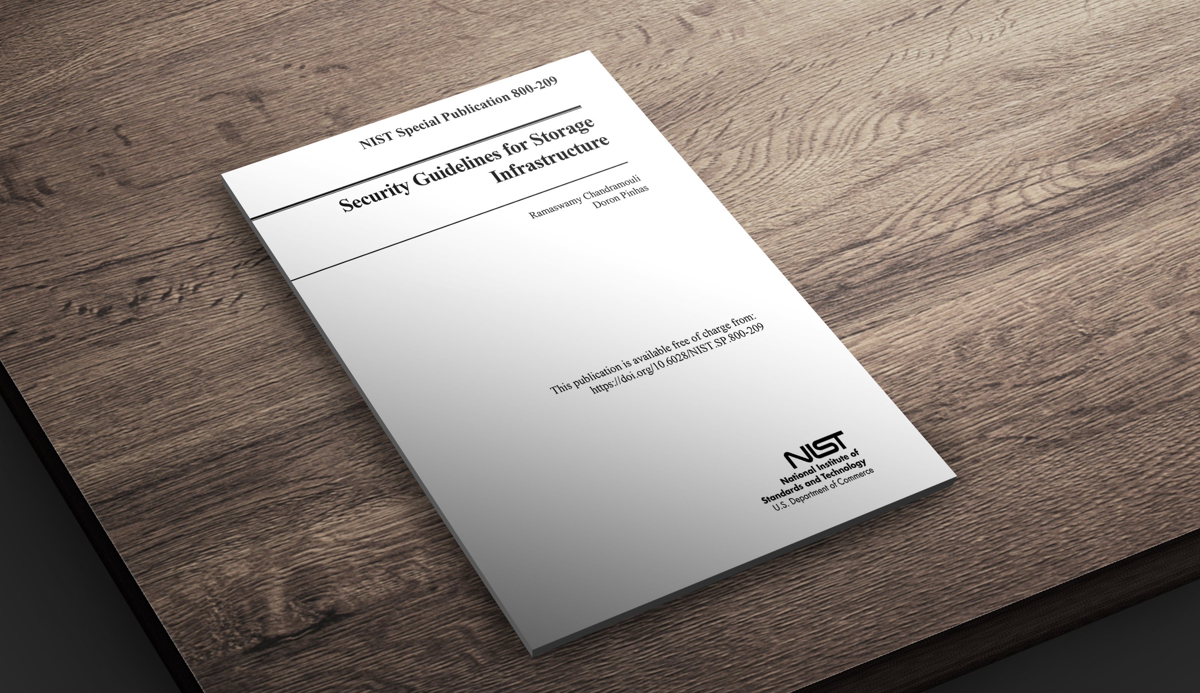


©2023 – Proprietary and Confidential Information of Continuity Software

Slide 17













THE RISK KNOWLEDGEBASE CATEGORIES
AUTHENTICATION
AD / LDAP, Vaulting, Radius
Kerberos, MFA
Login & passwd requirements
AUTHORIZATION
Role configuration Restricted Admin access
Default accounts / passwords
SAN / NAS
Zoning and masking CIFS and NFS access Port config
VENDOR BEST PRACTICES
Dell EMC, IBM, HP,
Hitachi
Cisco, Brocade, NetApp Infinidat, Amazon, more…
COVERAGE
Block Storage Arrays
Storage Switches
Storage Management
Storage Virtualization
Data Protection Appliances
Object Storage
Storage Area Network (SAN)
Server-based Storage (VSAN)
Network Attached Systems (NAS)
Backup Systems
Software-Defined Storage
HCI
Cloud Storage
ADMINISTRATIVE ACCESS
Management systems / Apps
CLI / API / SMI-S servers
Automatic logoff, sessions
ENCRYPTION
At rest / In transit
Encryption level, FIPS, Hashes
Admin / User access, SSL/TLS
VULNERABILITIES
Storage CVE detection Approved versions
LEADING STANDARDS
ISO 27001, NIST, CIS SANS
NYDFS, SEC, FFIEC, HIPAA
FIPS, PCI DSS and more.
AUDIT LOG
Central Logging Log Retention
Log Config and Immutability
SERVICES
/ PROTOCOLS
Telnet, FTP, RSH, SSH,
Rlogin
NFS, CIFS (SMB) SNMP, NDMP, SMTP
RANSOMWARE PROTECTION
Vendor / industry best practices
Protection policies
AND MORE…
Antivirus settings Time synchronization And more…

Slide 18
StorageGuard Support Matrix
SAN Arrays
File Storage & NAS
Storage Virtualization
Dell EMC Symmetrix • VMAX • PowerMAX
Dell EMC XtremIO • PowerStore
Dell EMC VNX • VNX2 • Unity • PowerVault ME
NetApp FAS/AFF • cDOT • 7-mode • filer
Hitachi VSP/USP • AMS • HUS • G-Series
IBM DS* •FlashSystem • IBM SVC • V7000/5000 • Storwize • Spectrum Virtualize • Spectrum Accelerate • N-Series
HPE XP • 3PAR* • Primera* • Nimble*
Infinidat InfiniBox
Pure • Huawei*
NetApp FAS/AFF • cDOT • 7-mode • IBM N-Series
Dell EMC Isilon • PowerScale • VNX/2 • Unity
Cohesity SmartFiles • HNAS* • HPE StoreEasy* • Infinibox • Pure • Huawei* • Nasuni*
Dell EMC VPLEX
IBM SAN Volume Controller • Spectrum Virtualize
NetApp FlexArray
Object Storage
Data Protection
Hitachi Content Platform (HCP) • Scality*
Dell EMC ECS • Cloudian HyperStore*
IBM Object Storage* • NetApp StorageGRID
Dell EMC RecoverPoint • Dell EMC Data Domain • Dell EMC PowerProtect DD • Dell EMC Avamar • IDPA
NetBackup • Commvault • HPE StoreOnce • Veeam • Cohesity • Rubrik • Networker*
IBM Spectrum Protect (TSM)
Dell EMC • IBM • HPE • Hitachi Vantara • NetApp • Infinidat • More.
Storage Management
Storage Network
Brocade directors / switches • OEM versions
Cisco MDS • Nexus • OEM versions
HP VirtualConnect / FlexFabric
Cloud Storage
Server-based SAN & HCI
Amazon Elastic Block Storage • S3 • Glacier
Azure Blob / Disk Storage*
Nasuni • Zadara*
NetApp Cloud Volumes ONTAP
Dell EMC PowerFlex (ScaleIO / vxflex OS)*
Dell EMC VxRail • VMware VSAN
Nutanix*
Storage Appliance
IBM Spectrum Scale* • Hadoop Appliance*
Oracle ZFS* • Oracle Exadata storage*
(*) roadmap items
©2022 – Proprietary and Confidential Information of Continuity Software
Notes:
Last updated: 18 July 2022
NetBackup Appliance – TBD
IDPA – Partially supported
VSAN, 3PAR – coming soon
Fujitsu OEMs of NetApp and other supported products - supported
HPE Simplivity
Netapp Solidfire

Slide 19




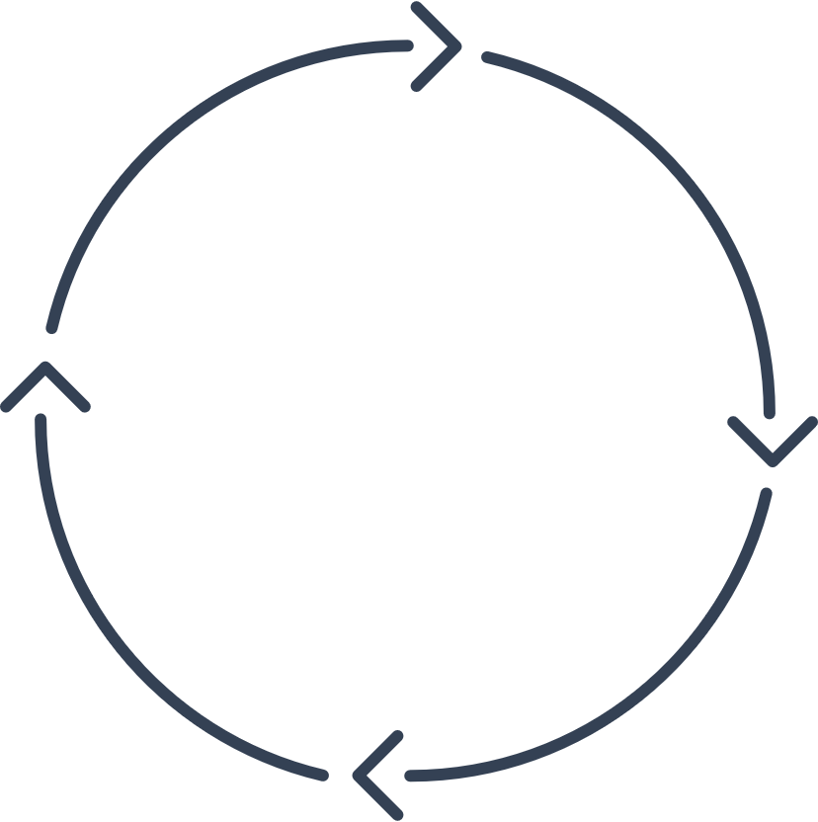



How It Works
Daily collection of configuration from all converged / storage / backup layers
Non-intrusive
Agentless
On-Prem
Collect
Detect
Analyzes configurations using a built-in risk detection engine
Detects security misconfigurations and vulnerabilities
1
2
4
Single-pane-of-glass for ensuring security of storage environment
Automatically reports on successful resolution of issues
Sends actionable alerts to appropriate teams
Suggests remedial steps
Integrates with existing management systems
3
Visualize & track
Prescribe
©2023 – Proprietary and Confidential Information of Continuity Software

Slide 20
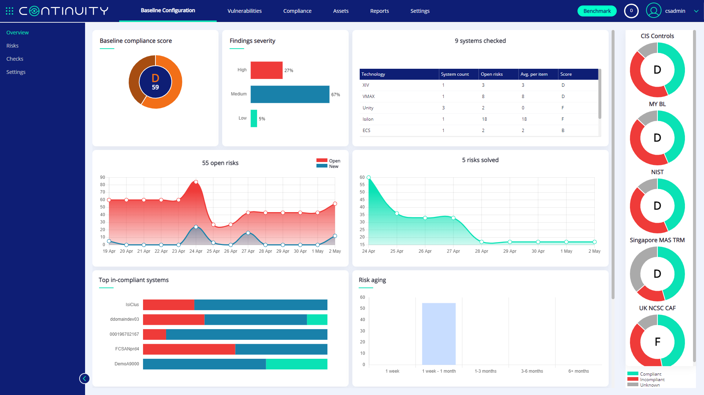
Notes:
To be replaced with growing resolved and lowering open

Slide 21
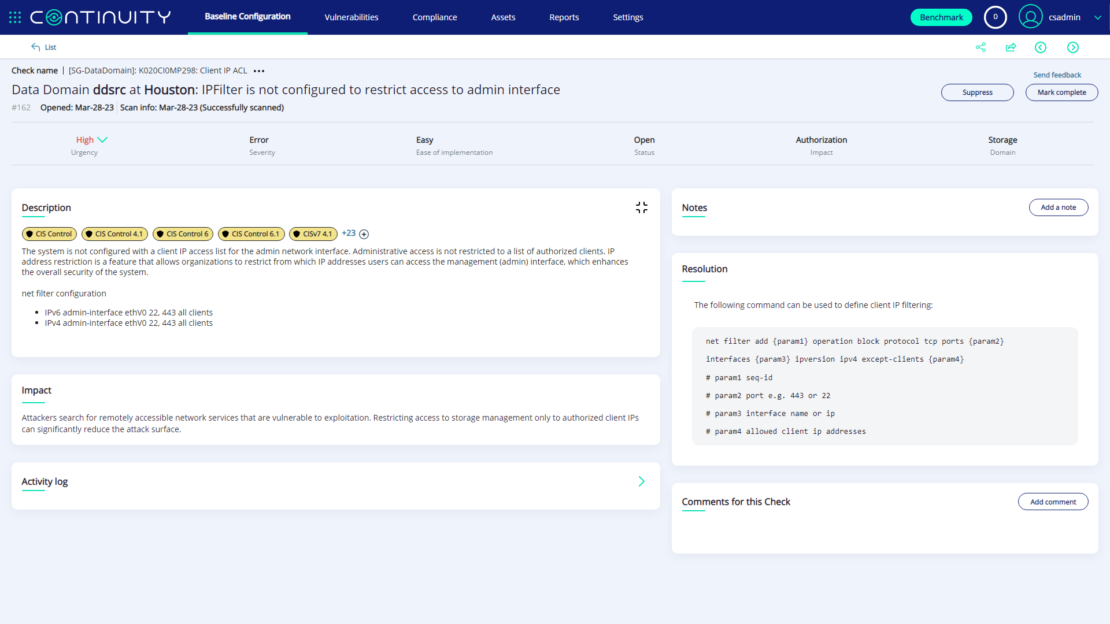

Slide 22
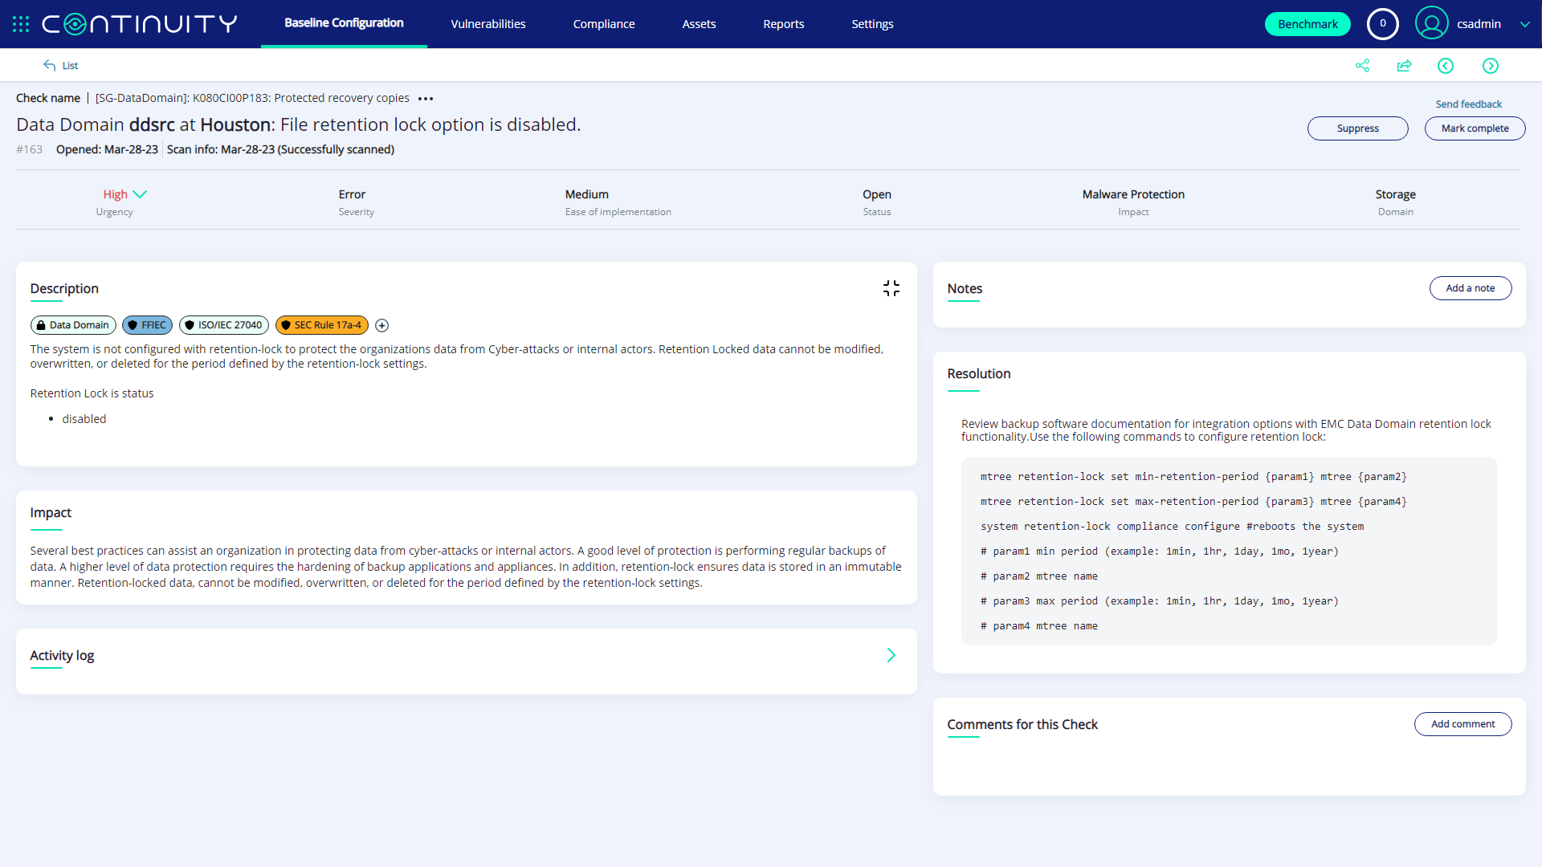
Screenshot 1

Slide 23
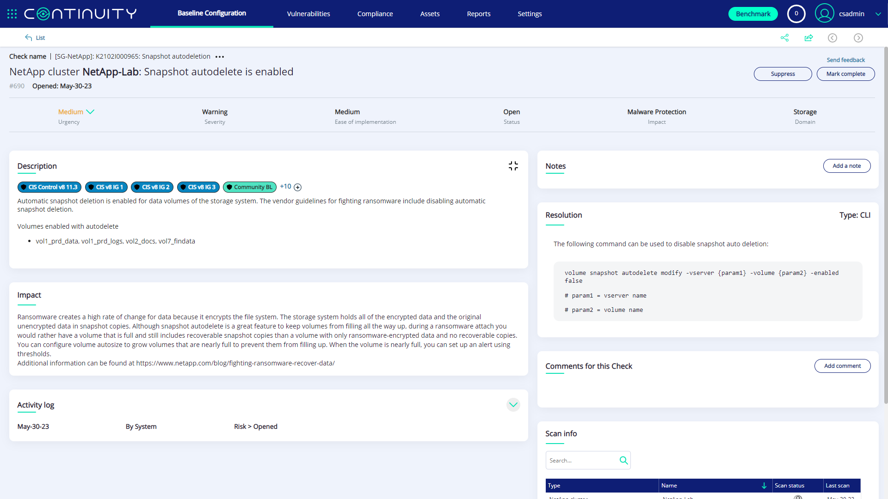

Slide 24
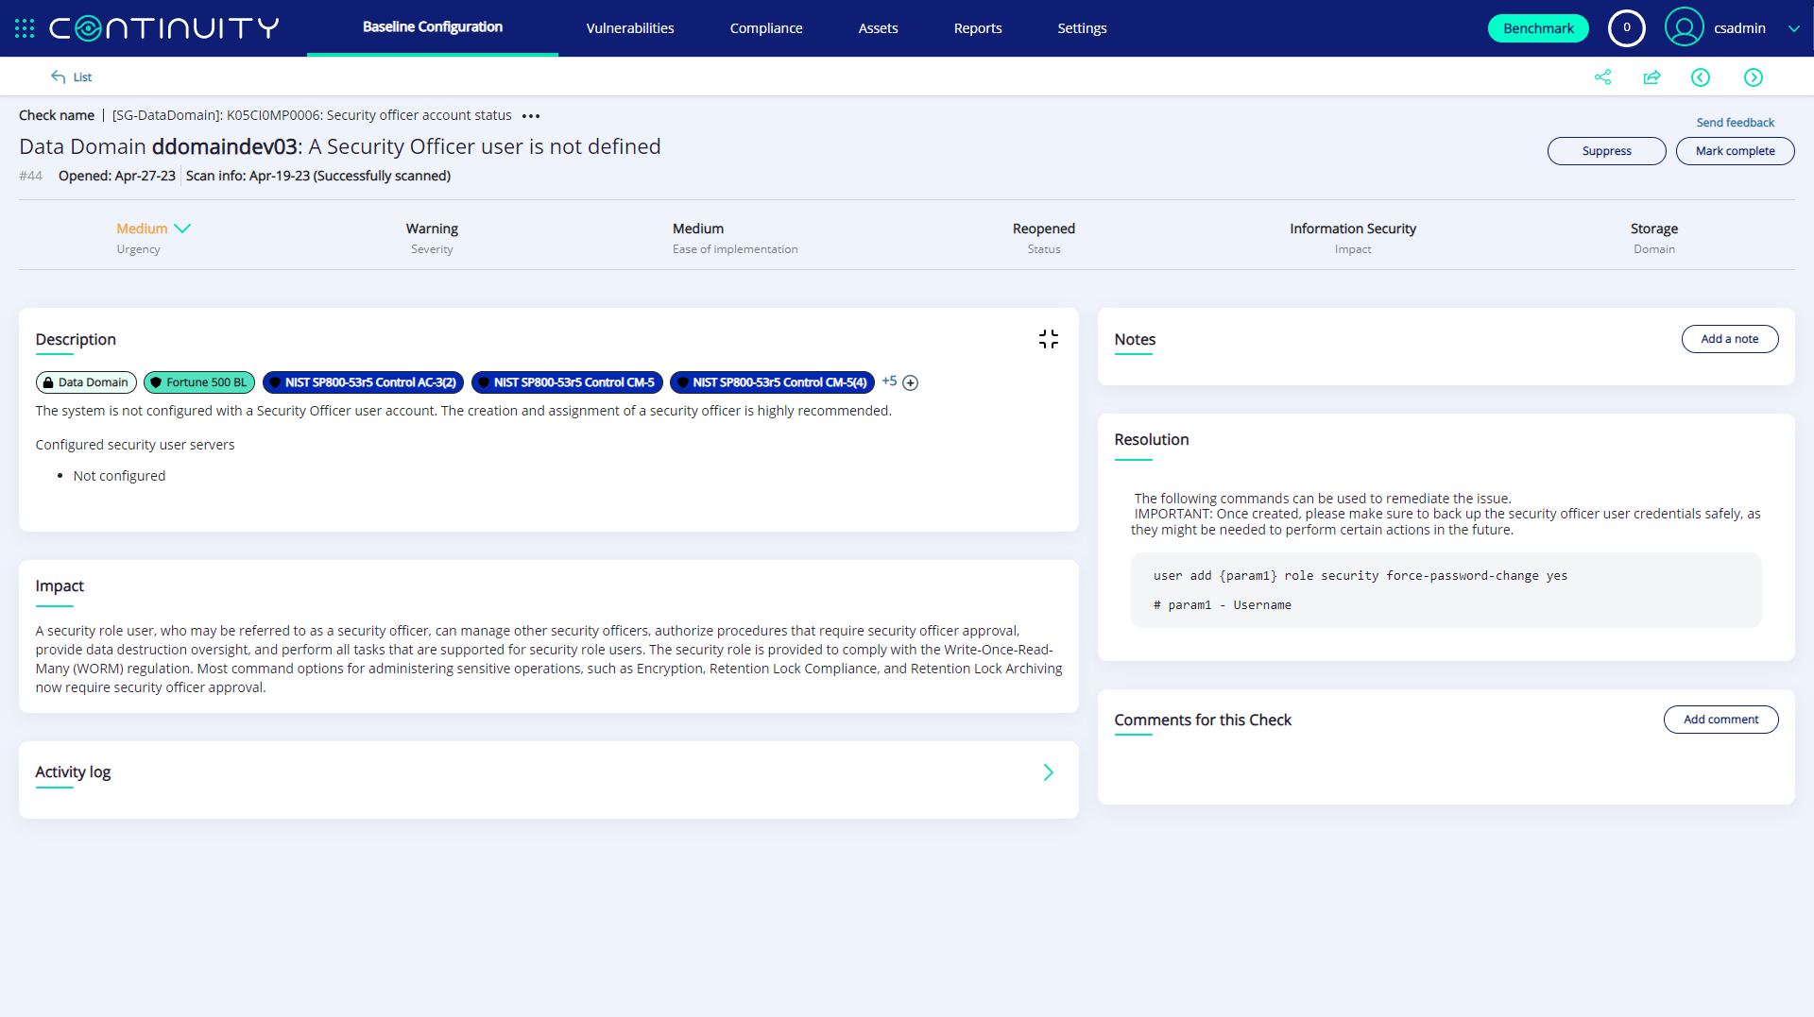

Slide 25
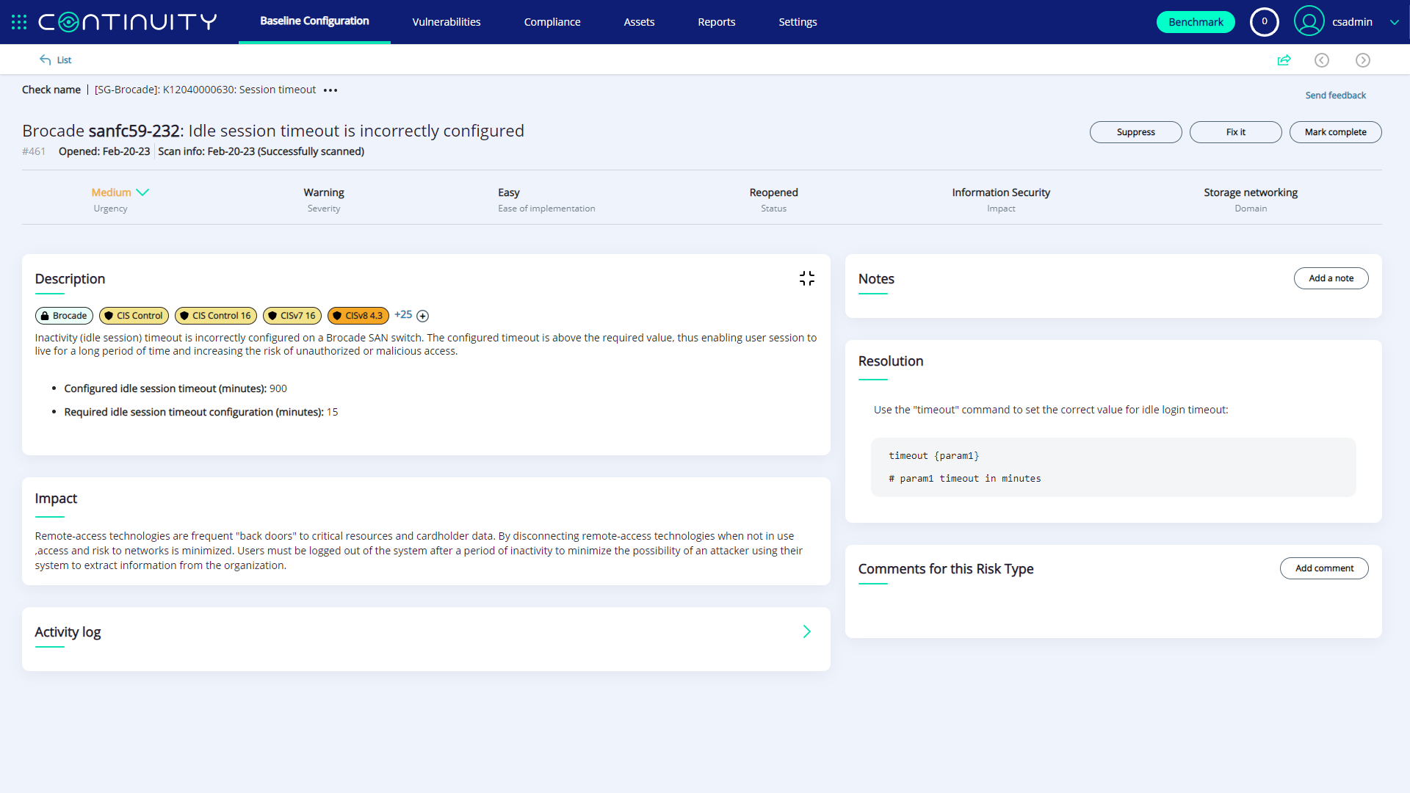

Slide 26
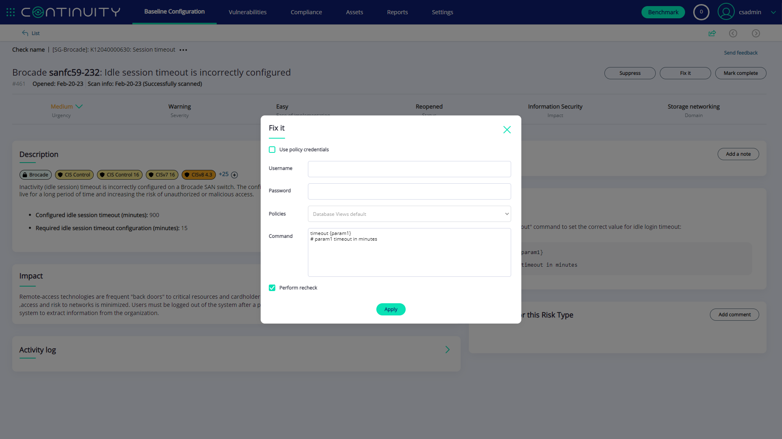

Slide 27


Slide 28
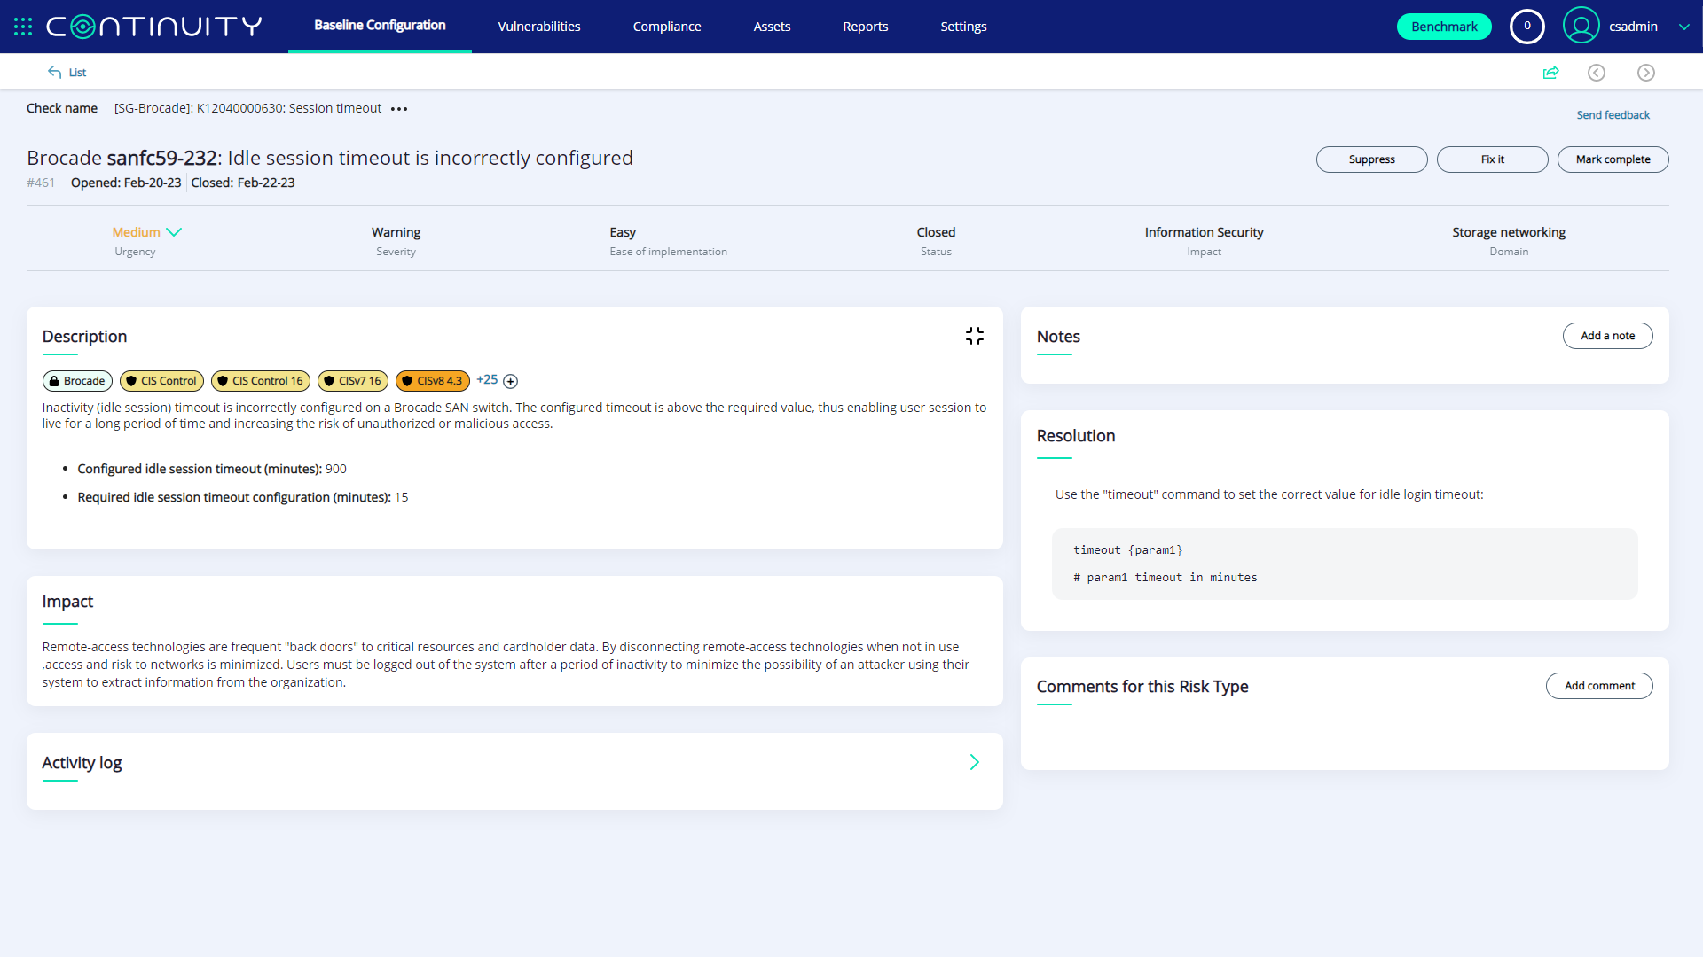
Notes:
Fix closed date

Slide 29
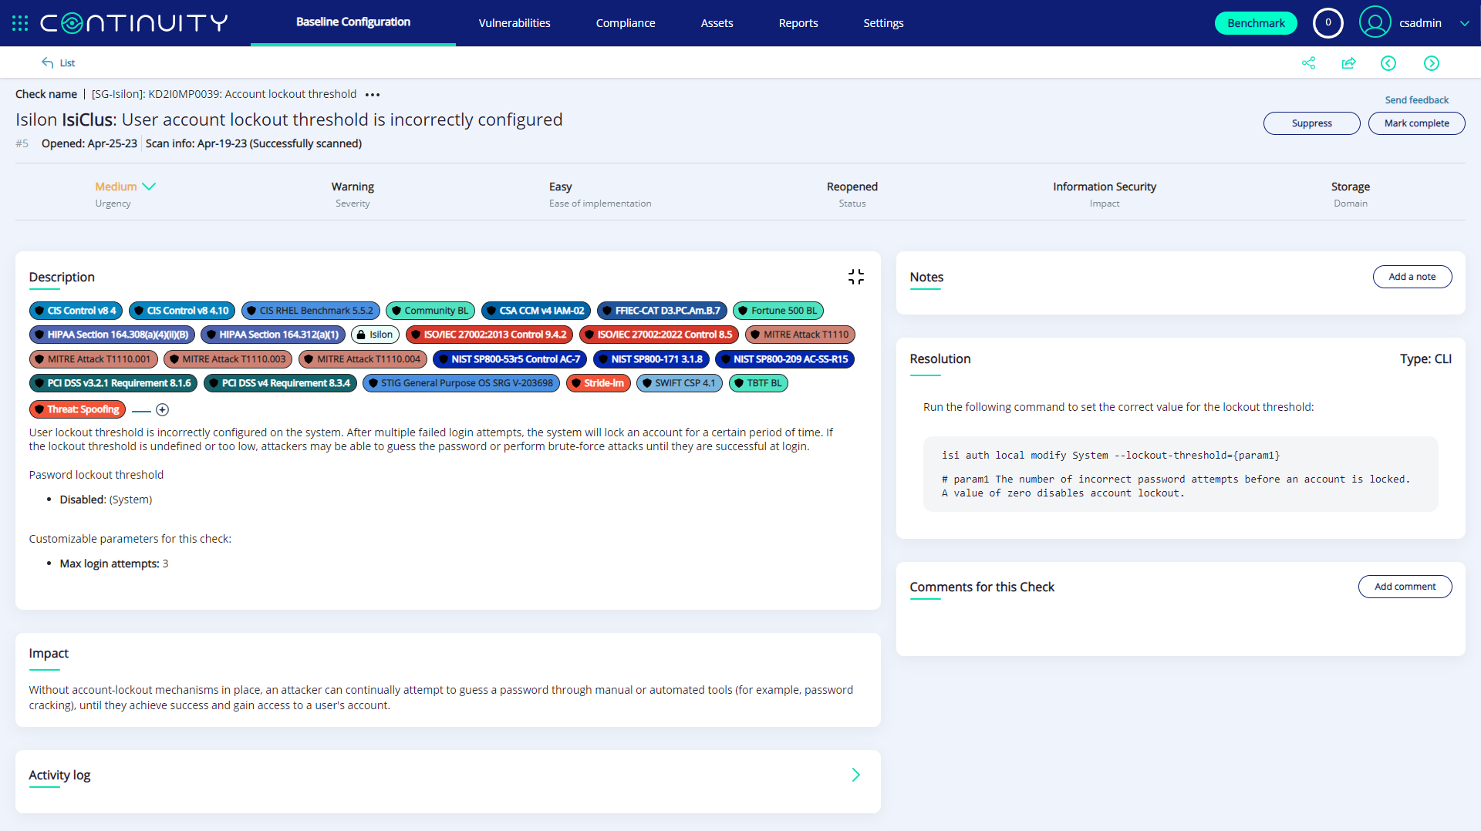
Labels map the finding to associated guidelines of information security standards, regulator guidelines, vendor guidelines, CIS Implementation groups (IG), NIST baselines and related threats

Slide 30
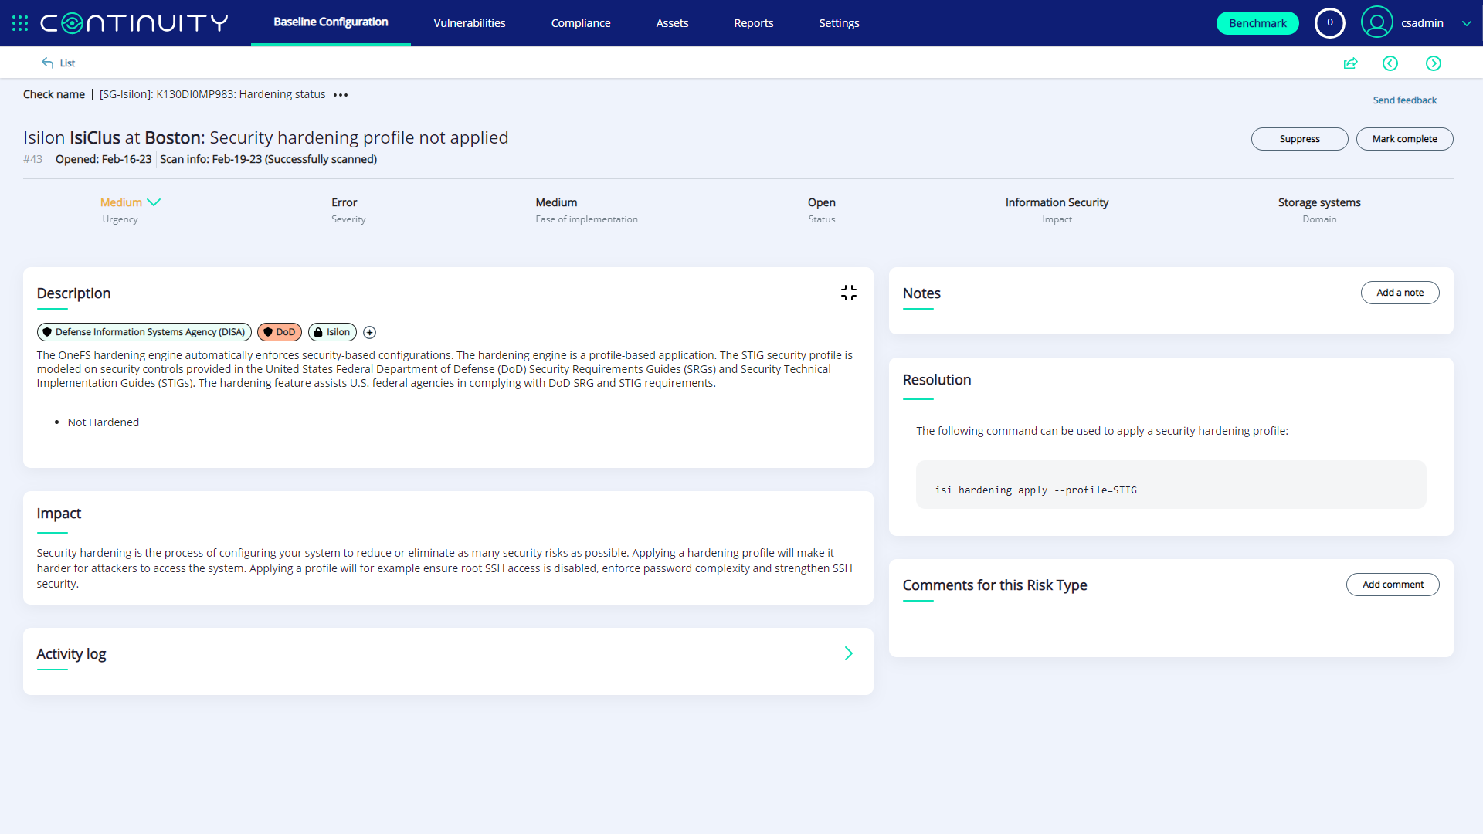

Slide 31
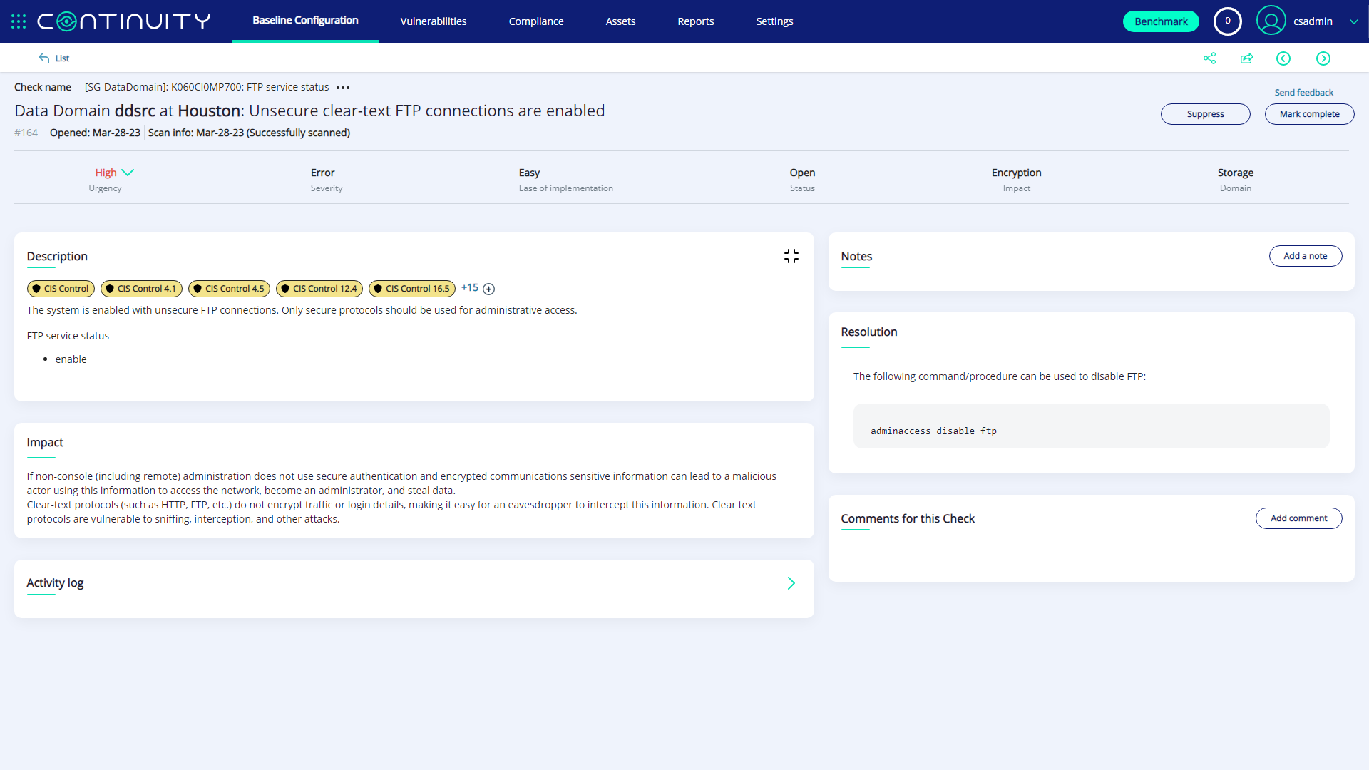

Slide 32
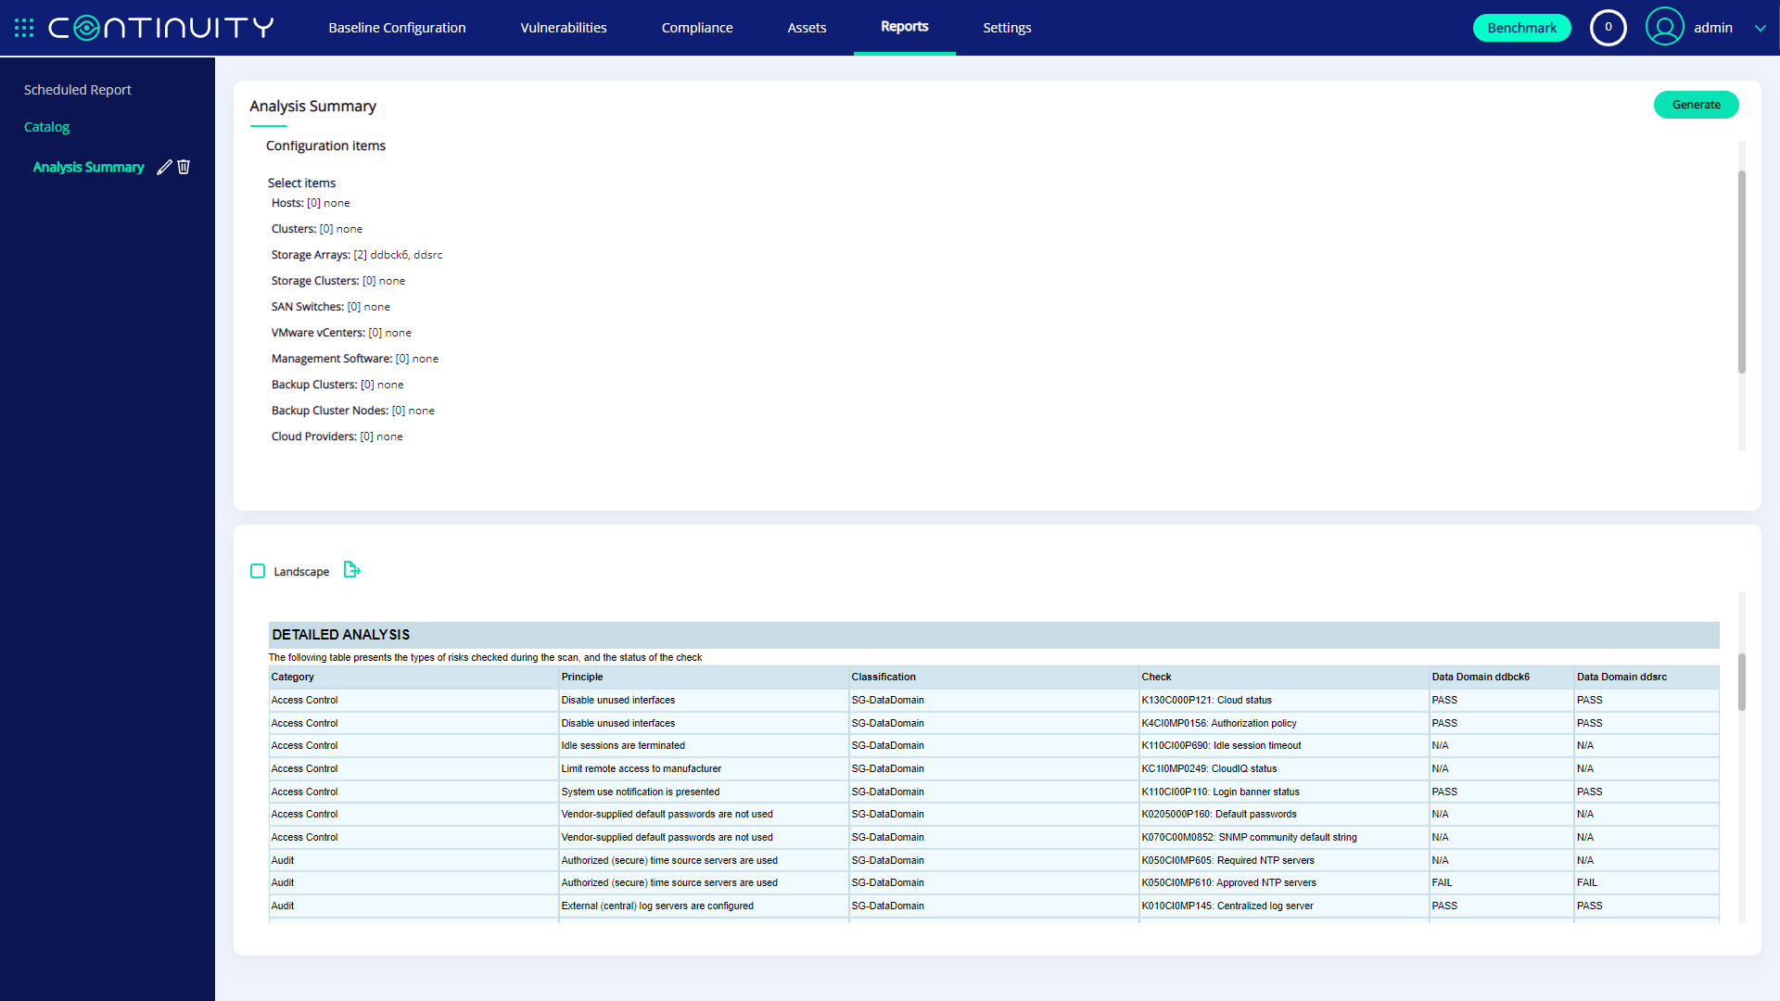
Export to Excel | Word | PDF

Slide 33
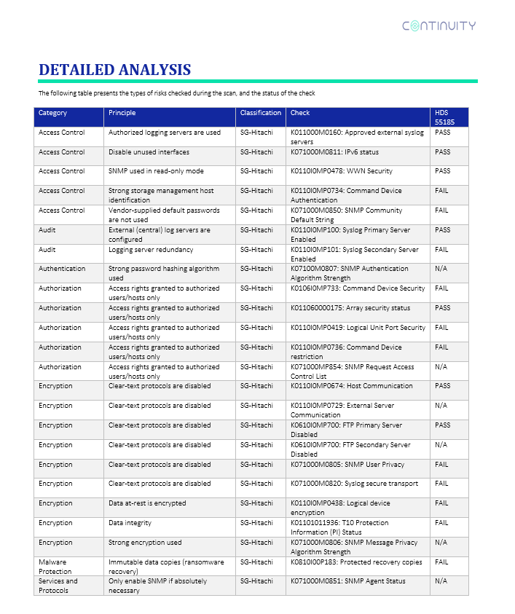
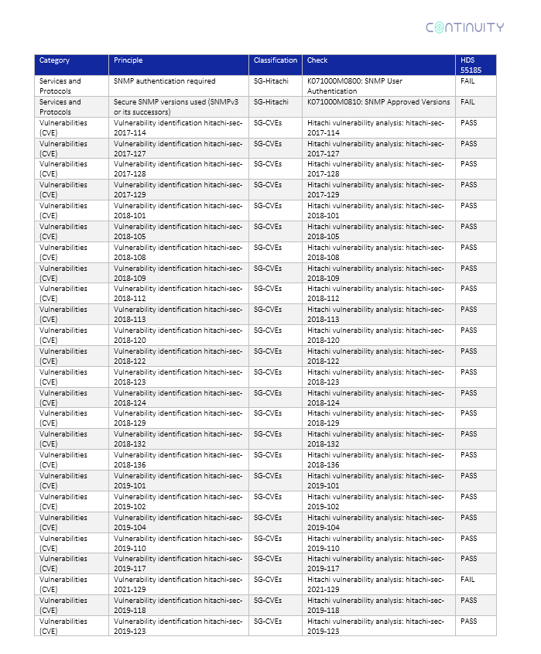
Detailed PASS/FAIL reporting
©2023 – Proprietary and Confidential Information of Continuity Software

Slide 34
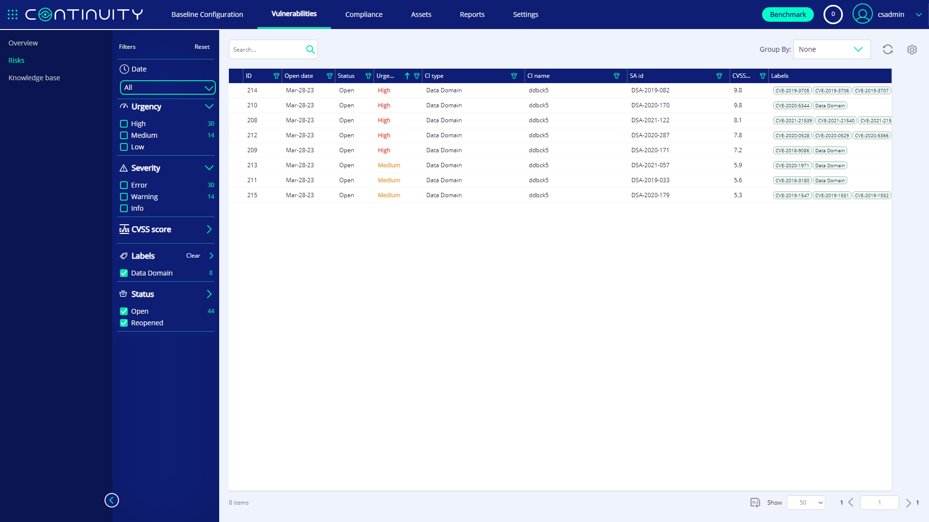

Slide 35
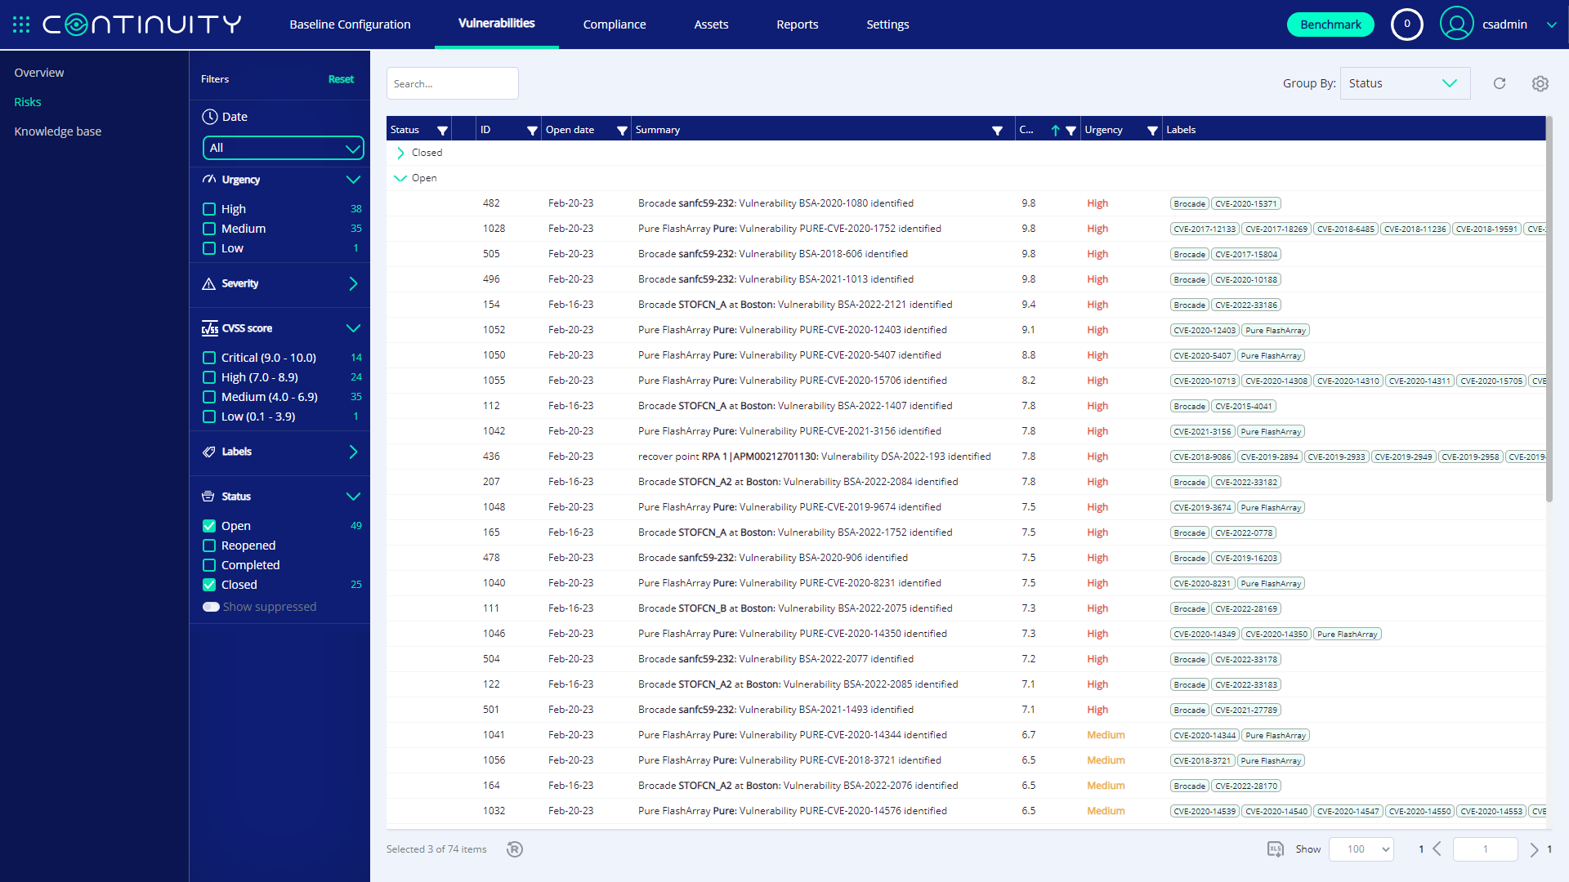

Slide 36
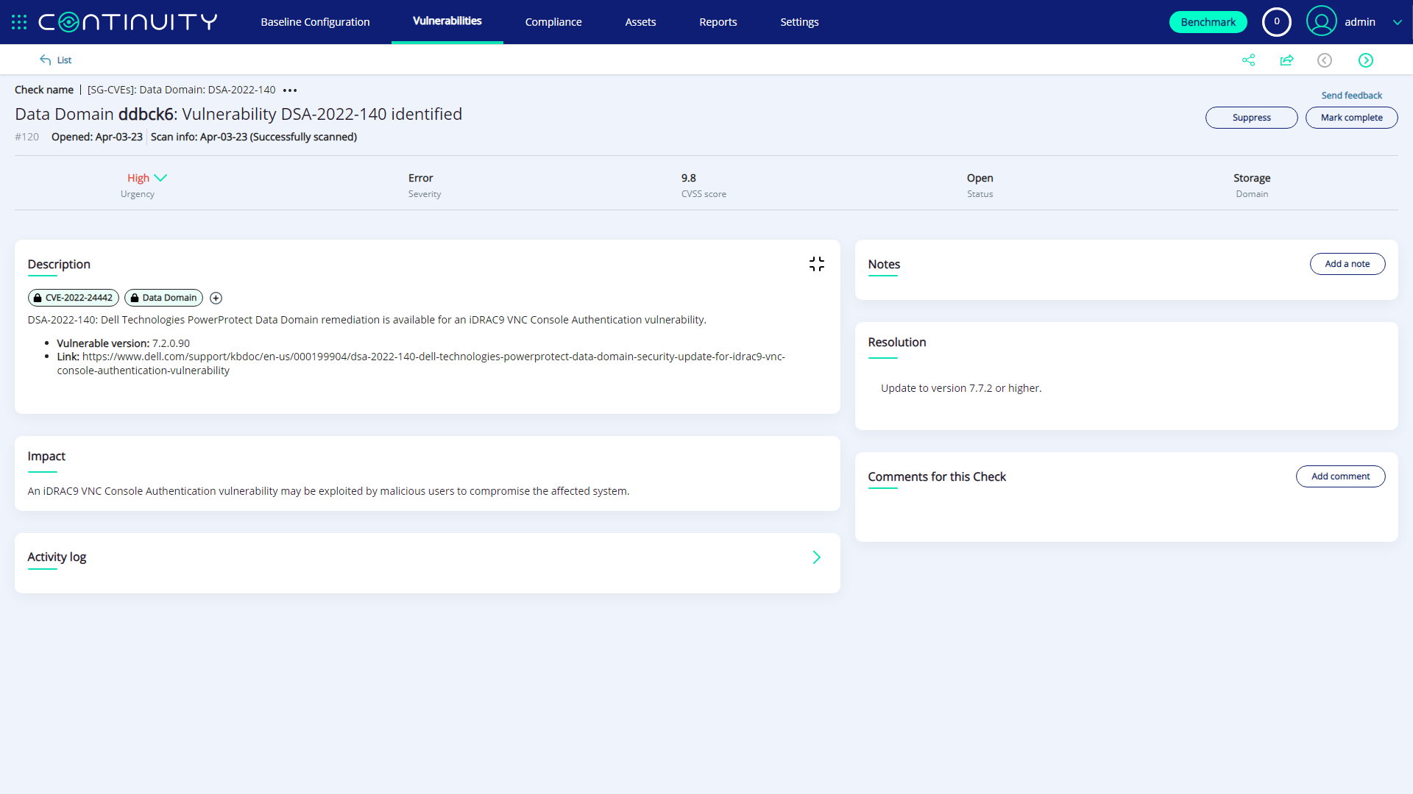
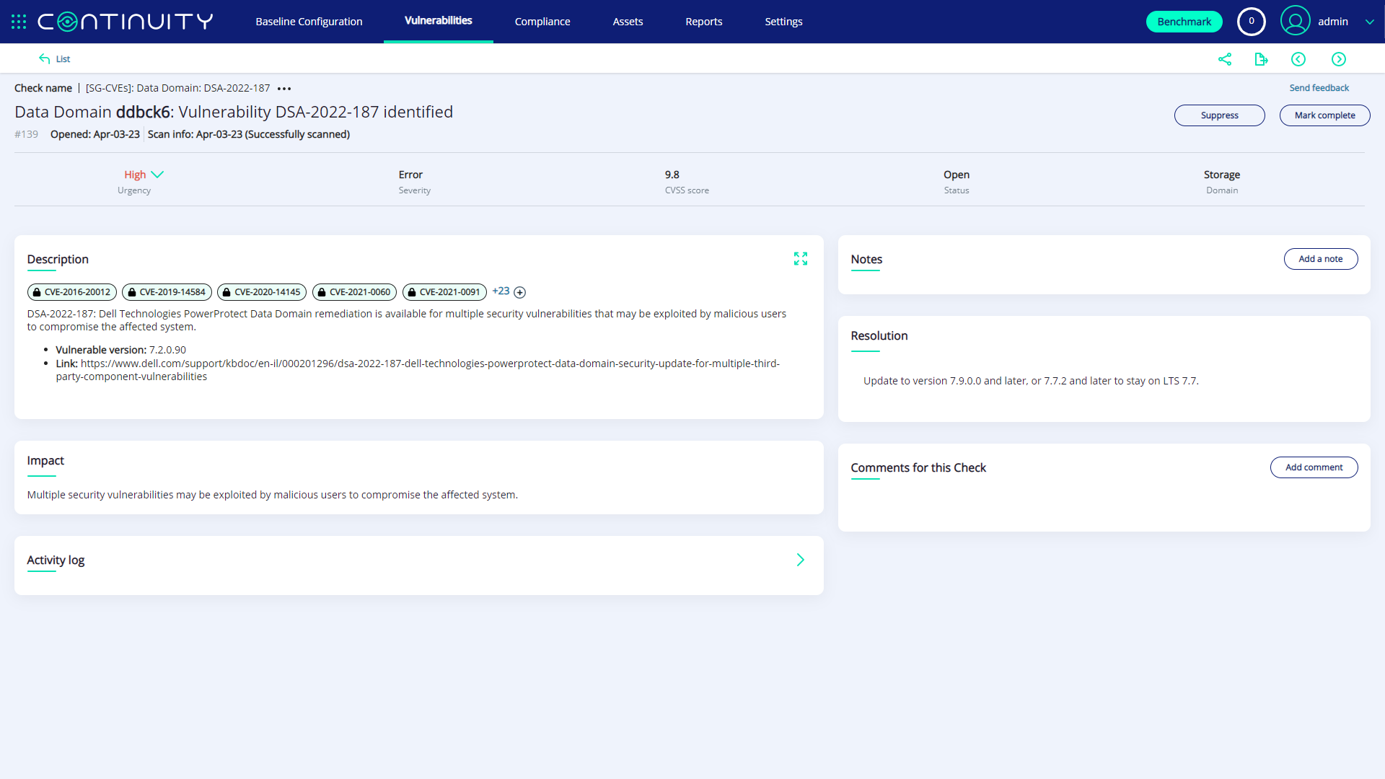

Slide 37
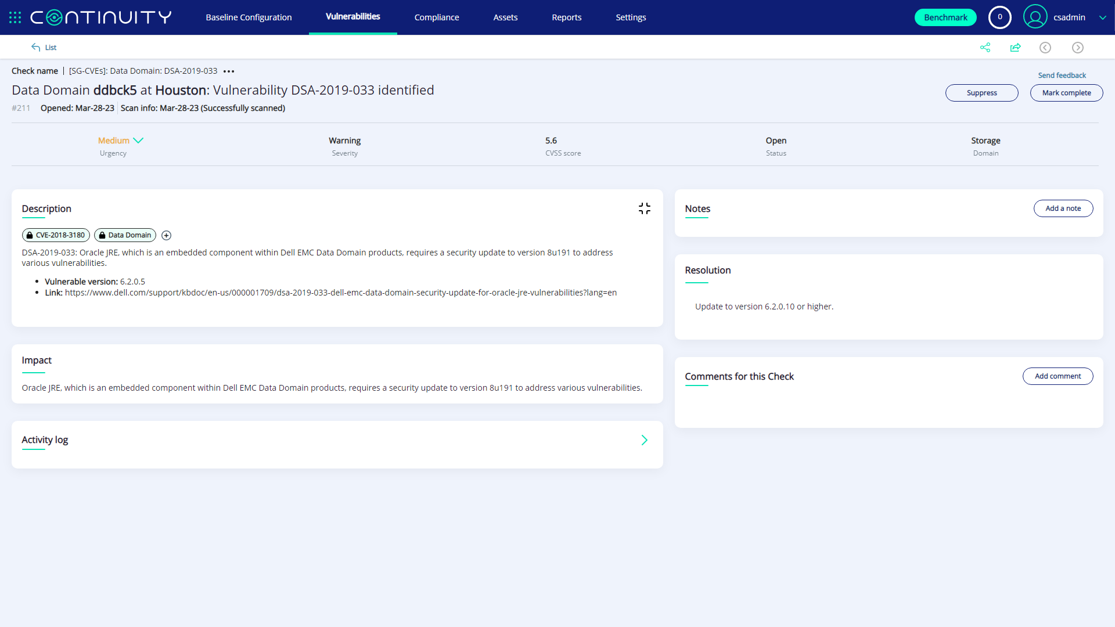

Slide 38
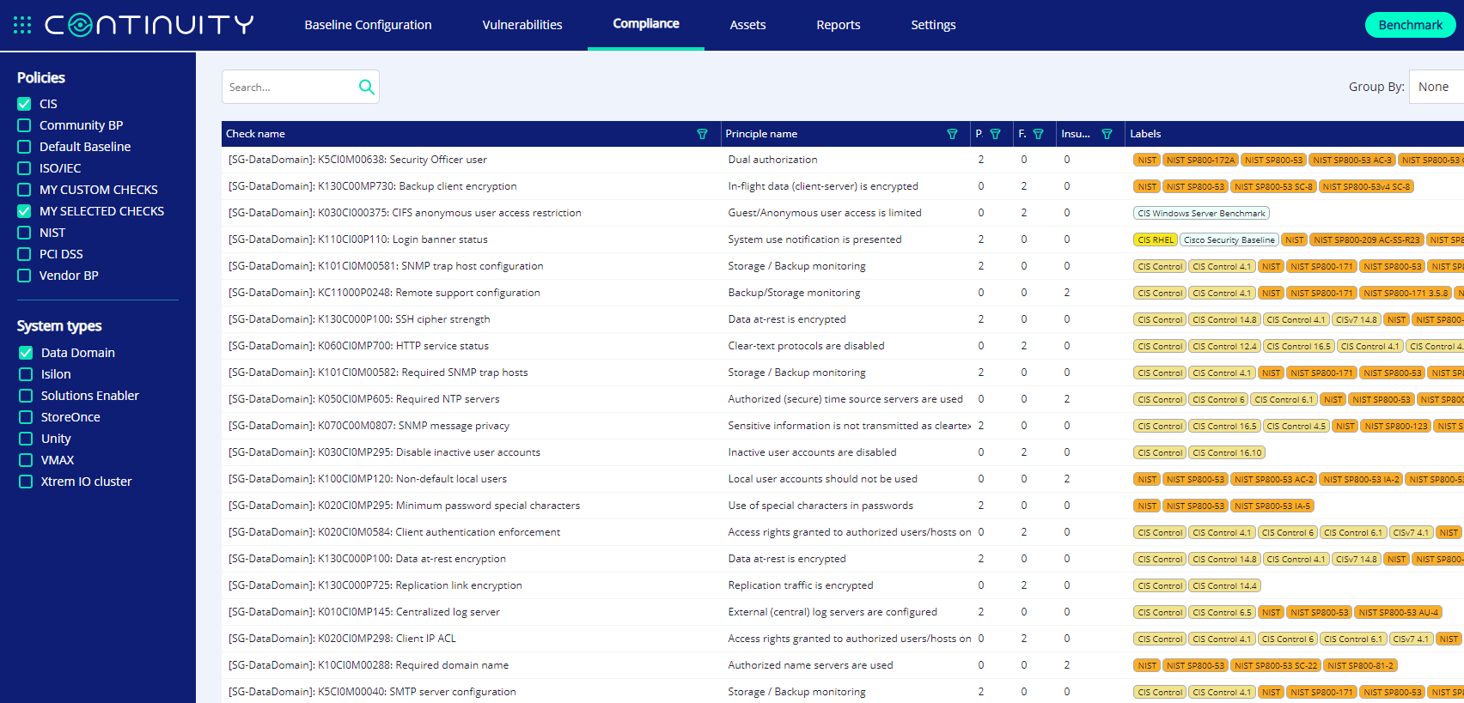
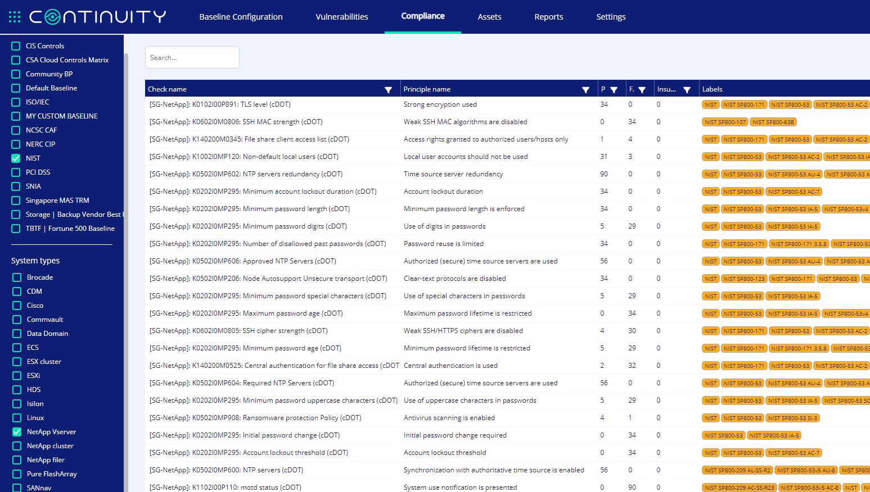
Compliance View
Pass Count
Fail Count

Slide 39
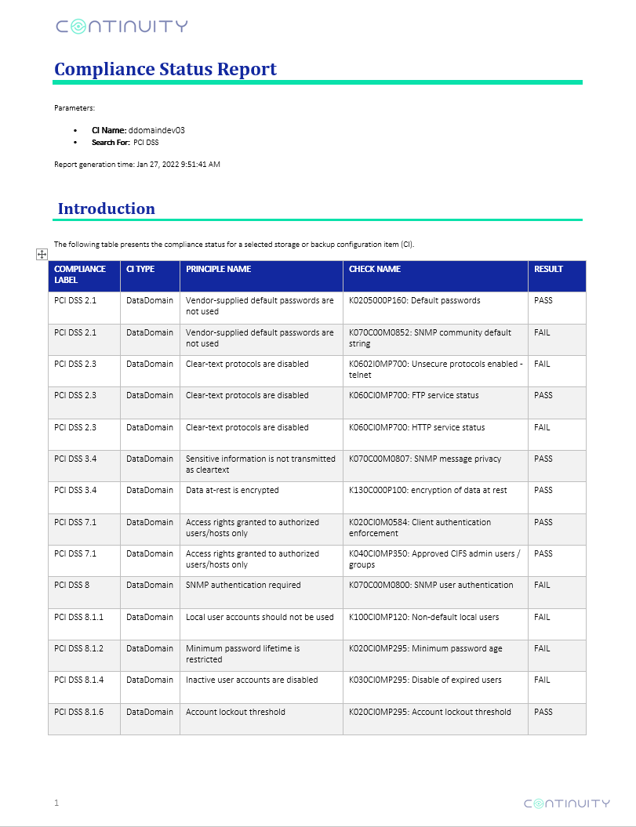
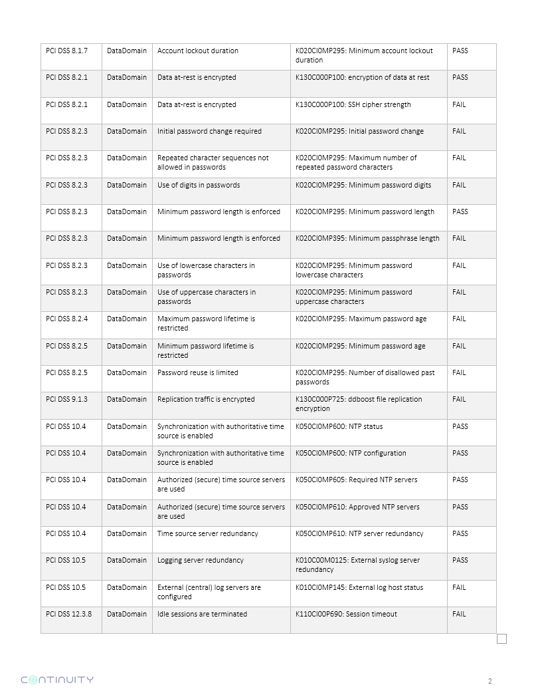
Compliance Status Report
©2023 – Proprietary and Confidential Information of Continuity Software

Slide 40
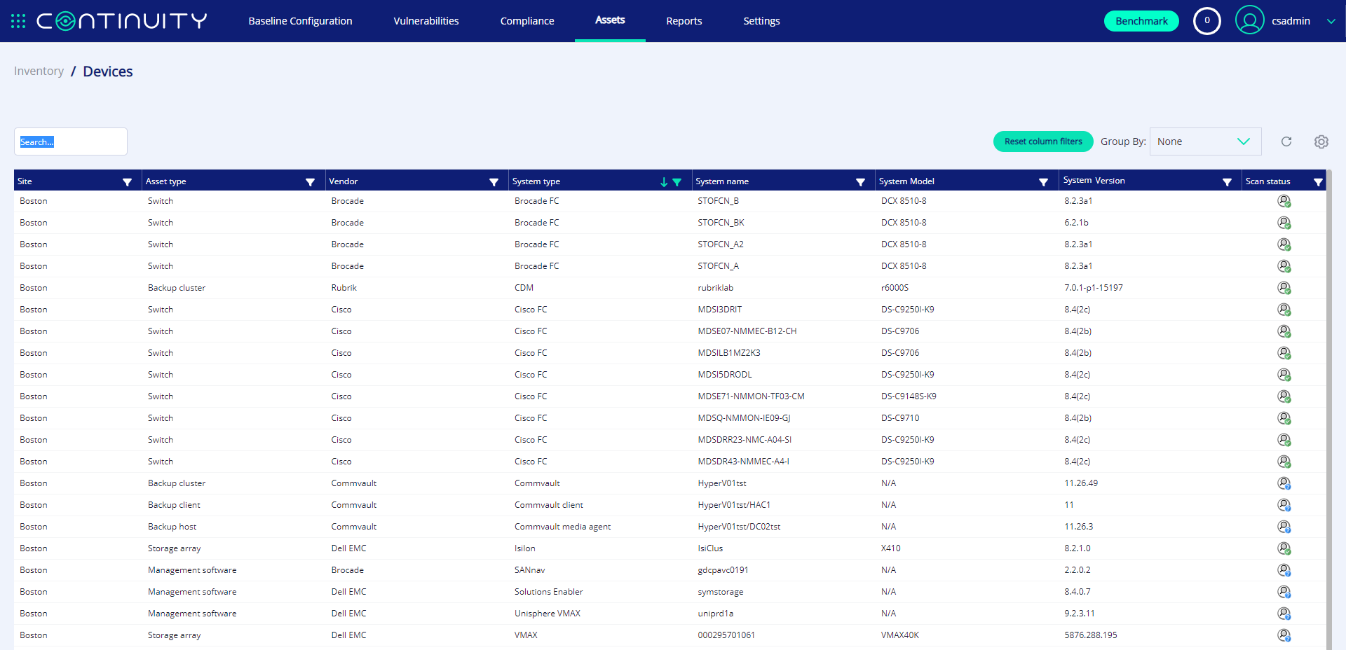
Storage/Backup Asset Inventory

Slide 41
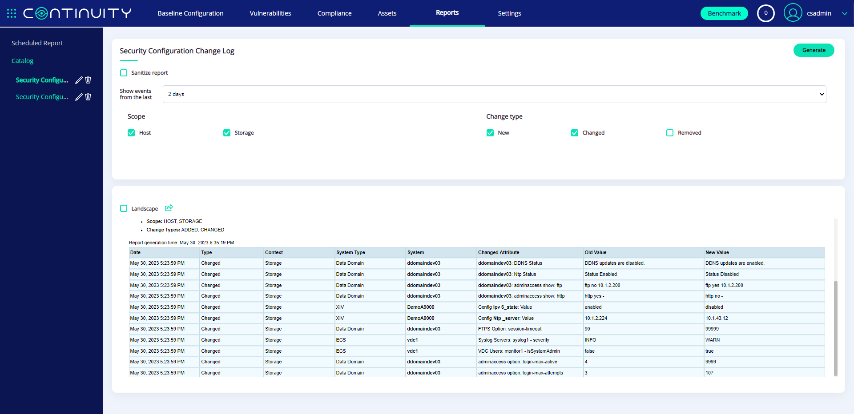
Configuration Change Tracking

Slide 42
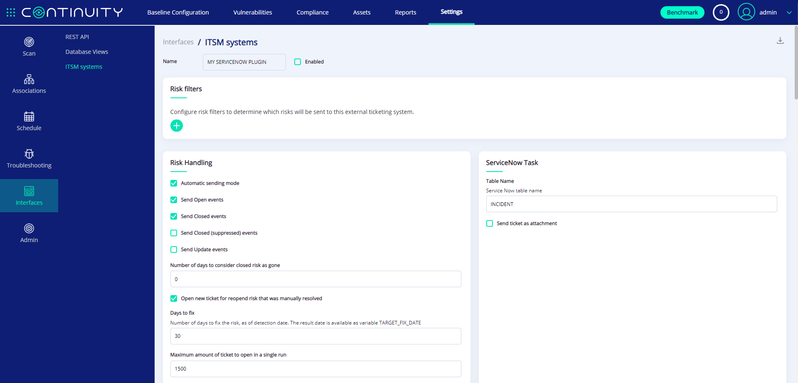
ITSM Integration

Slide 43
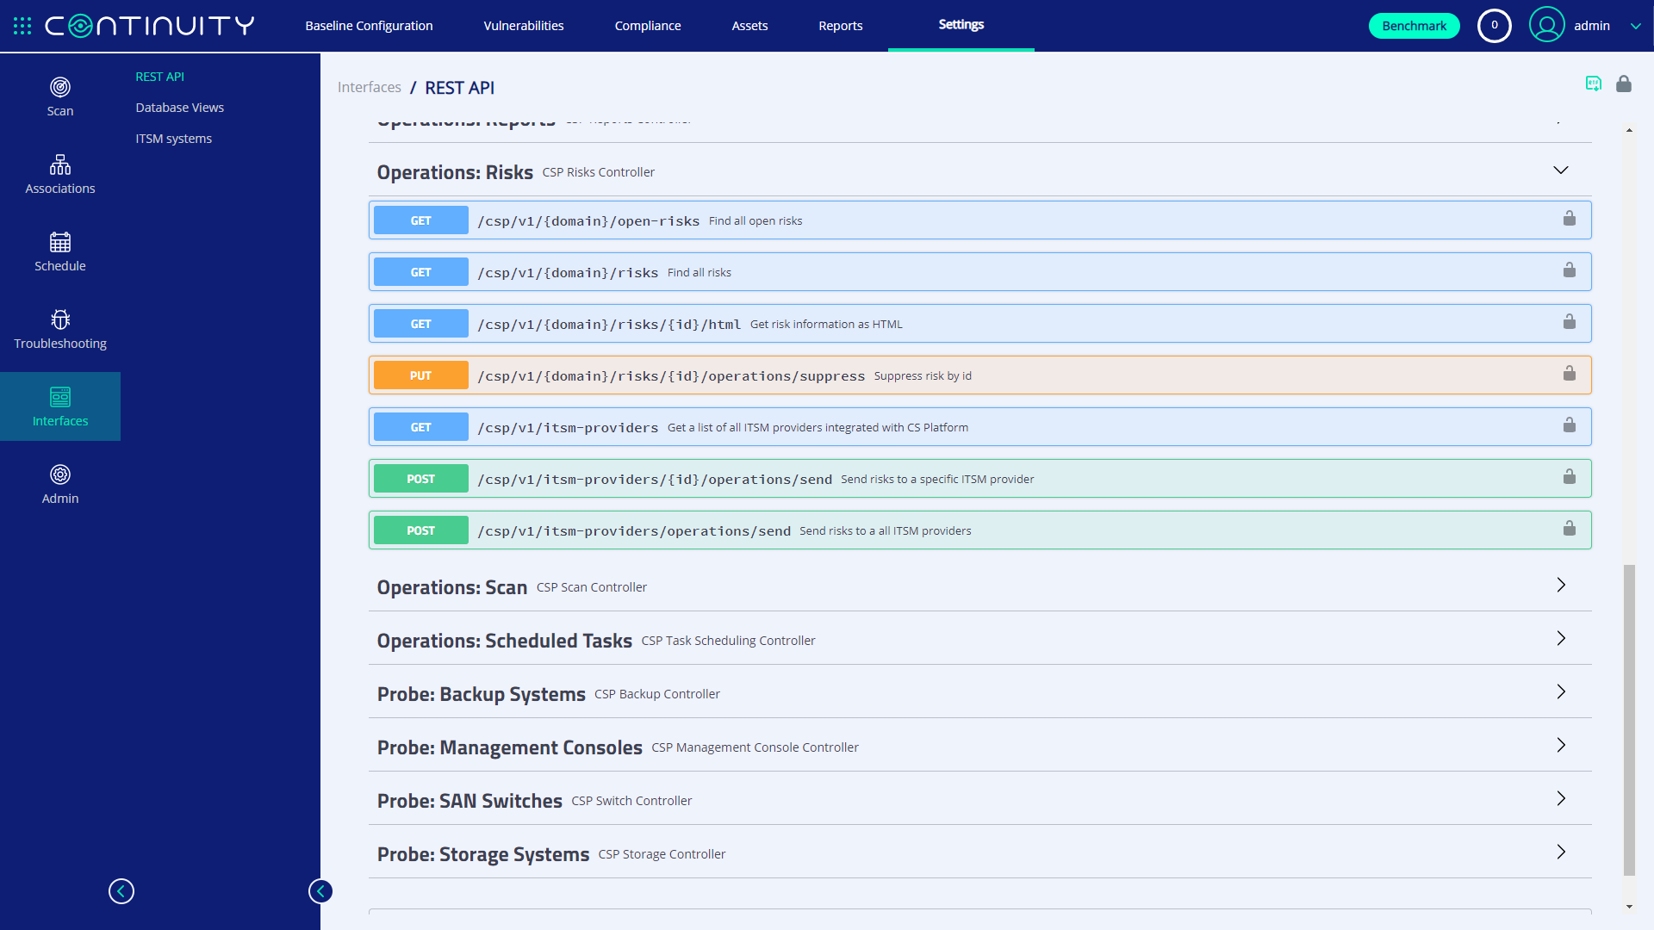

Slide 44
How It Works
Daily collection of configuration from all converged / storage / backup layers
Non-intrusive
Agentless
On-Prem
Collect
Detect
Analyzes configurations using a built-in risk detection engine
Detects security misconfigurations and vulnerabilities
1
2
4
Single-pane-of-glass for ensuring security of storage environment
Automatically reports on successful resolution of issues
Sends actionable alerts to appropriate teams
Suggests remedial steps
Integrates with existing management systems
3
Visualize & track
Prescribe
©2023 – Proprietary and Confidential Information of Continuity Software

Slide 45
Benefits of StorageGuard
Built-in library of thousands of checks for Storage/Backup technologies
AUTHENTICATED vulnerability scan for Storage and Backup
Security misconfiguration detection: vendor best practices, industry guidelines and community-driven
Configuration drift from selected baseline
Automatic misconfiguration remediation
Vulnerability detection
Compliance reporting: CIS, NIST, PCI DSS and more
Storage and backup Inventory
Define custom checks
  Protect your Storage and Backup Environment – with StorageGuard

Slide 46
Benefits of StorageGuard
Ensure storage and backup systems are continuously hardened and can withstand ransomware and other attacks
Continuously validate against your chosen storage/backup security baseline
Eliminate manual security validation efforts
Leverage remediation guidance to speed time-to-resolve
Ongoing reporting and dashboarding of remediation status and risk reduction trends
Meet IT Audit requirements: Achieving, sustaining, and providing evidence for compliance
Eliminate configuration drift – by tracking security configuration changes
Risk knowledge base routinely updated by Continuity Software
Easily customizable with additional checks specific to your requirements
  Protect your Storage and Backup Environment – with StorageGuard

Slide 48
StorageGuard Proof-of-Concept (POC)
Learn how to achieve continuous storage/backup security, by running a StorageGuard POC
A POC covers up to 9 scenarios:
  Scan of up to 3 selected storage/backup systems
  Detection of security risks
  Remediation guidance
  Auto-validation of remediated risks
  Security baseline creation
  Security baseline reporting and continuous validation
  Compliance reporting
  Integration and routing options
  Custom checks
Details: See StorageGuard POC Plan
Duration: Up to 5 joint work sessions (typically over a 2-week period)
Conclusion: Presentation of POC Summary & Results to Senior Management

